Slide 1

Reliability Validation Test Substantiation
Begins at 2:15 PM, Wednesday, April 6th
Ing. Ronald Schop
Sr. Director Reliability
Holland Innovative BV

Slide 2
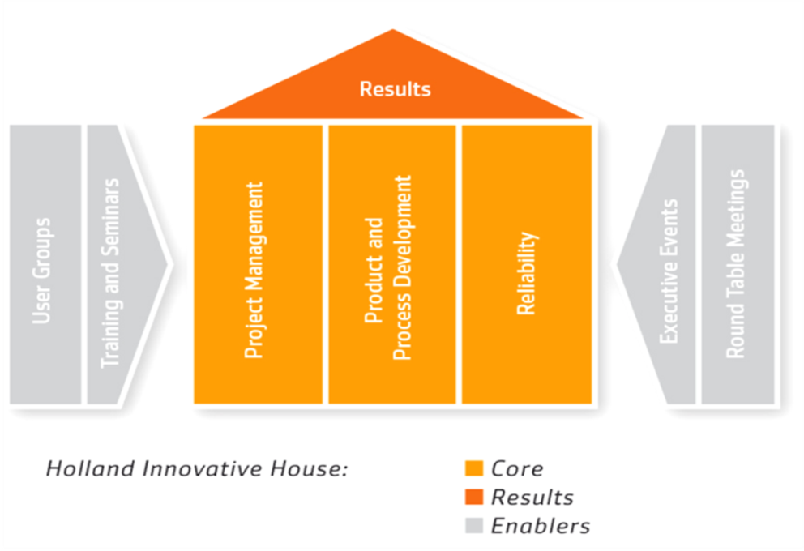

Introduction
Holland Innovative BV

Slide 3

Subject
RVP - Reliability Validation Plan
Notes:
TX-SX: Title of presentation
Presenters Name
Page 3
Subject of today’s presentation I the RVP.
A tool I developed > 10 years ago within DAF Trucks.
- Help Engineers and testing dept. to create a proper FMEA – they see that it is used after completion.
- Deals with Engineering efforts
- Includes Statistics, but without the real statistical background knowledge required.
These day’s used by all major DAF suppliers, so it seems to work fine…

Slide 4
Agenda
Purpose of the RVP
Method and Background
RVP Interface
RVP Results
Summary
Questions
Notes:
TX-SX: Title of presentation
Presenters Name
Page 4

Slide 5
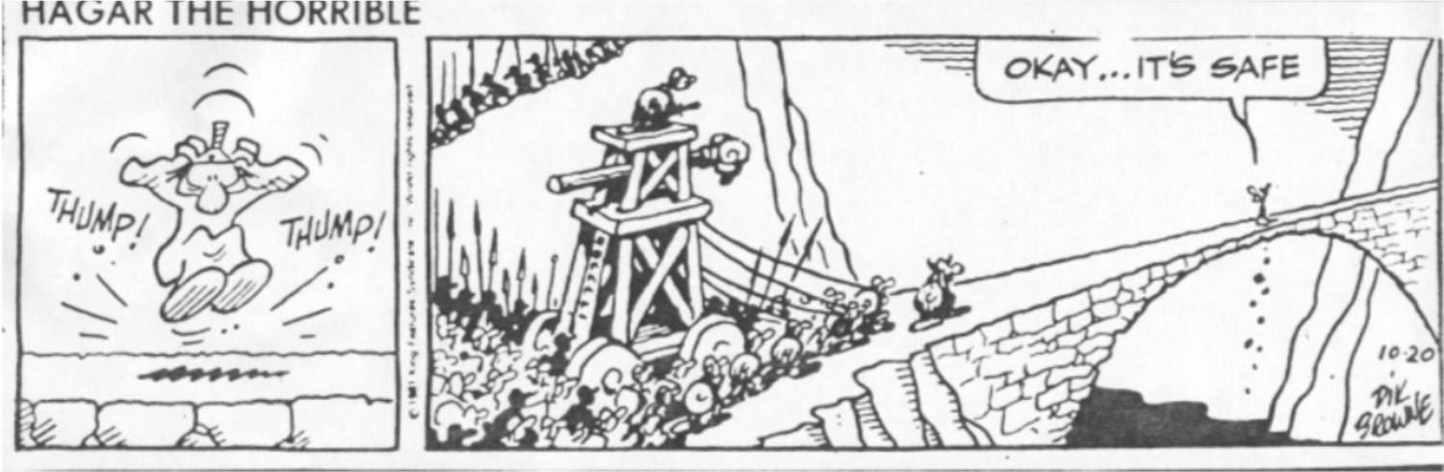
Purpose of the RVP
From Subjective to Objective judgement

Slide 6

Purpose of the RVP
Awareness & Involvement
Aware that a Risk Mitigation Plan can be Quantified
Involved in the Risk Analysis & Mitigation process

Slide 7
Method and Background
Weibayes Zero Failure Testing Principles
  Zero failures
  Weibull β is “known”
  First failure is imminent
  Minimal Reliability

Slide 8
Method and Background
Old age
Wear out
Infant
Mortality
Early
Wear out
Random
β < 1
β = 1
1 < β < 4
β > 4

Slide 9
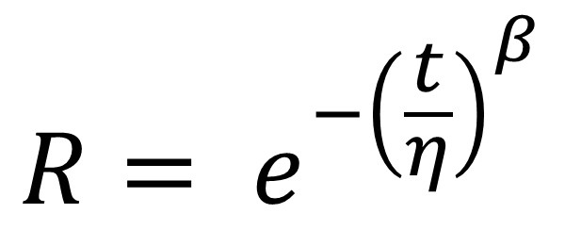
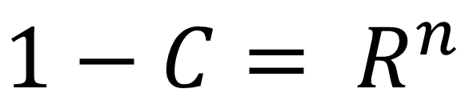
Method and Background
Combination Weibull Distribution & Binominal Confidence = Probability calculations
$$R= e^{−{\left(\frac{t}{η}\right)}^{β}}$$
$$1−C= R^{n}$$
Notes:
Note that in Germany often the term Lv (Lebensdauerverhältnis) is used for t/T – Testtime / Reliability demonstration Time

Slide 10
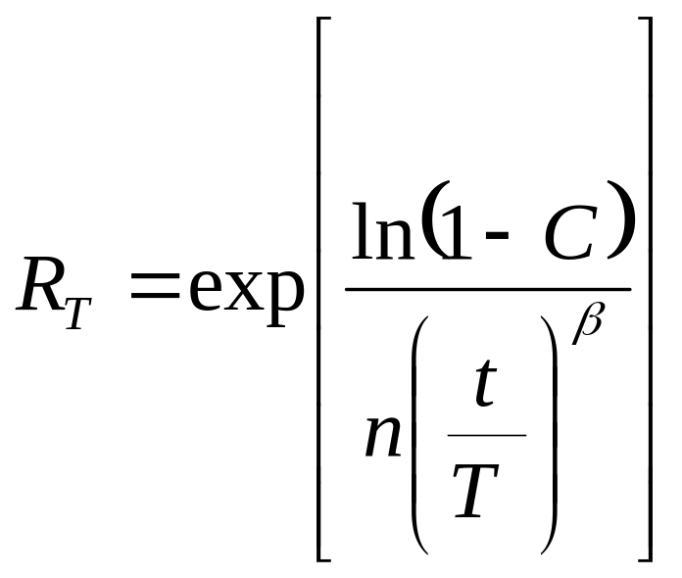
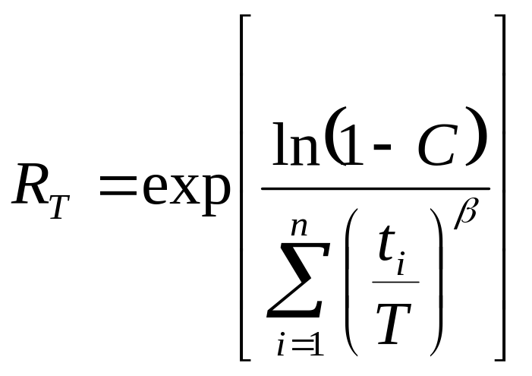
Method and Background
C. Julius Wang (1999)
Reliability Demonstration
or

Slide 11
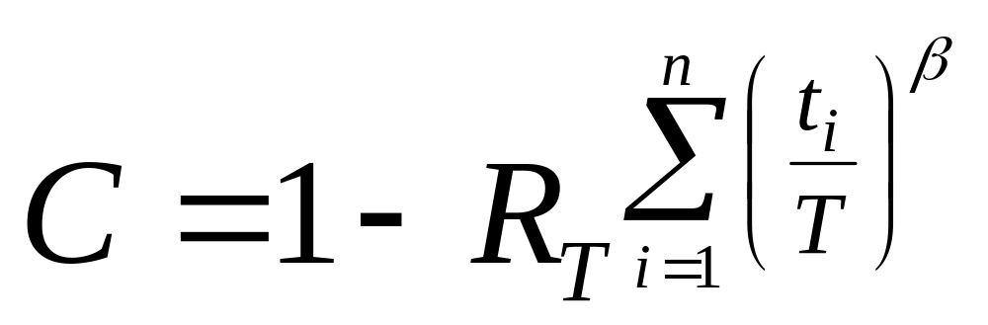
Method and Background
Confidence Level Demonstration
Confidence = “Probability of Detection” (PoD)

Slide 12
Method and Background
Example: R _{T} = 0,95 T = 100 t = 150
n = 10 Bèta = 2
The “Confidence Level” = PoD = 68%
PoD = Probability of Detecting One or more failures, IF the Component Reliability @ time T is 0,95 or lower

Slide 13
Method and Background
Example: R=0,8 @Time T and Beta = 3
n =

Slide 14
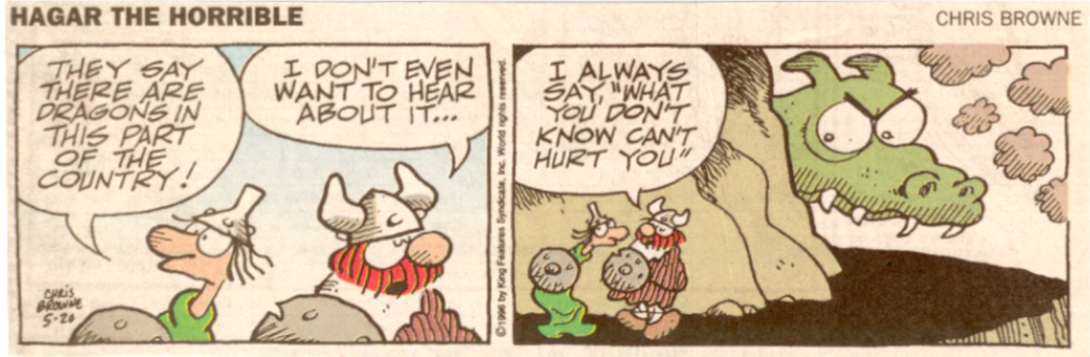
Method and Background
Test Credit
Non-testing activities; Engineering activities

Slide 15
Test Credit
Max. 50% Test Credit
Engineering Activity | Test Credit
Warranty Analysis of the previous design | 5 %
Reliability Analysis previous design | 5 %
Strength Calculations, Fatigue calculations | 10 %
Stress measurements | 5 %
FEM analysis + verification of stresses | 10 %
FMEA completion | 5 %
Laboratory test results | 10 %

Slide 16
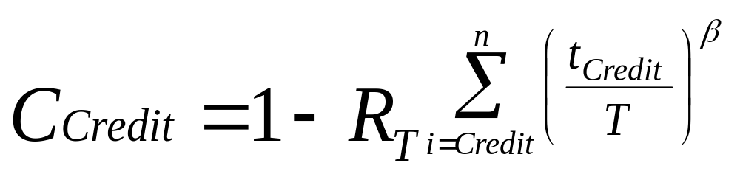
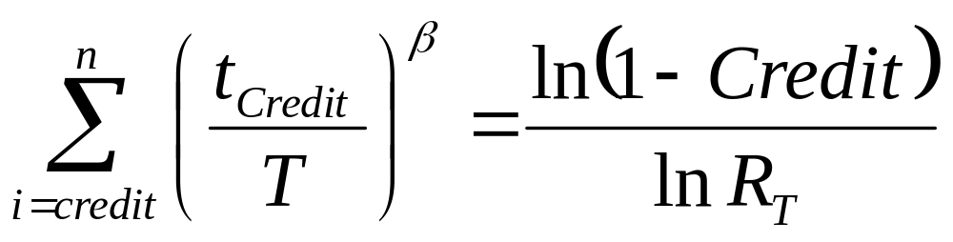
Test Credit
From Credit to Confidence
from which:
The Test Credit is transformed to an equivalent test length t_{Credit}

Slide 17



RVP Flowchart
Start
Reliability Target
Additional
Activities / Test
Failure-Modes
Test Credit
OK ?
Planned Tests
Test Relevance
End

Slide 18
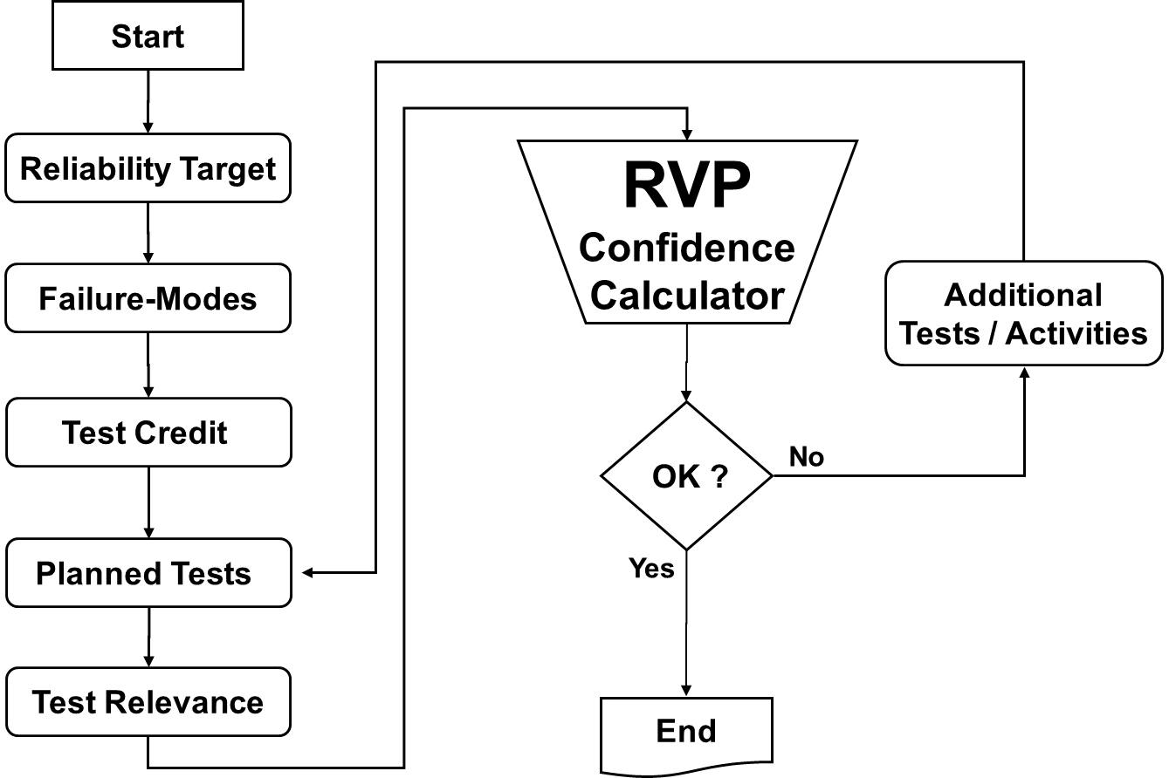
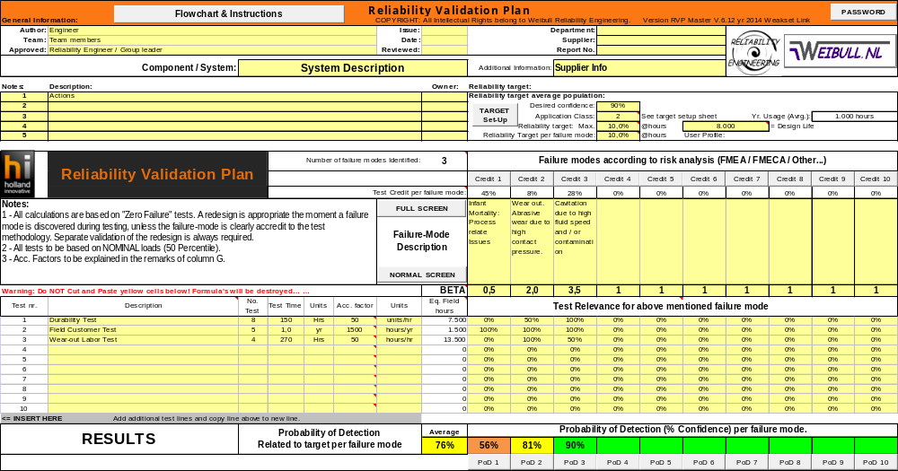
RVP Interface
1 – Start: General Information
Notes - Actions
2 - Reliability Target
4 – Test Credit
3 - Failure Modes +
Weibull slopes
5 - Planned Test
6 - Test Relevance
7 - Results

Slide 19

1 – General Information
1 – Start: General Information
Most important is to …

Slide 20
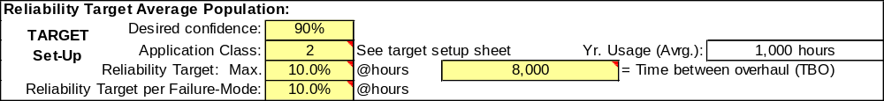
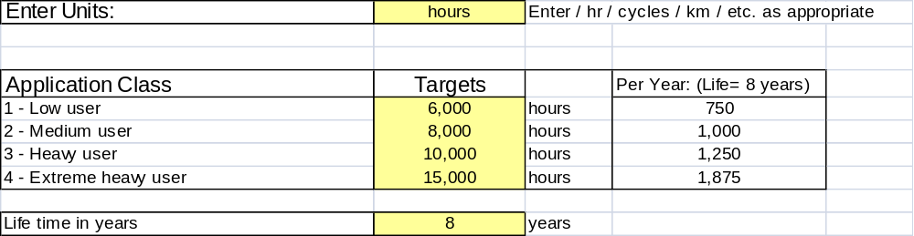
2 – Reliability Target
Notes
2 - Reliability Target

Slide 21
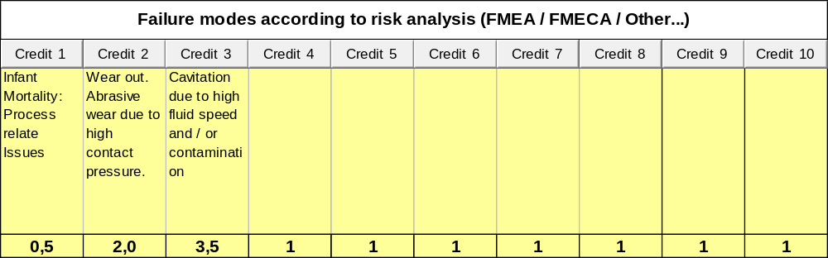
3 – Failure Modes or Mechanisms
Notes
2 - Reliability Target
3 - Failure Modes +
Weibull slopes

Slide 22
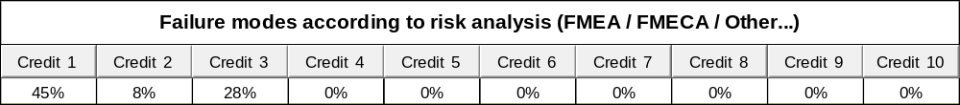
4 – Test Credit
Notes
2 - Reliability Target
4 – Test Credit
Per Failure Mode
Test Credit Calculator

Slide 23
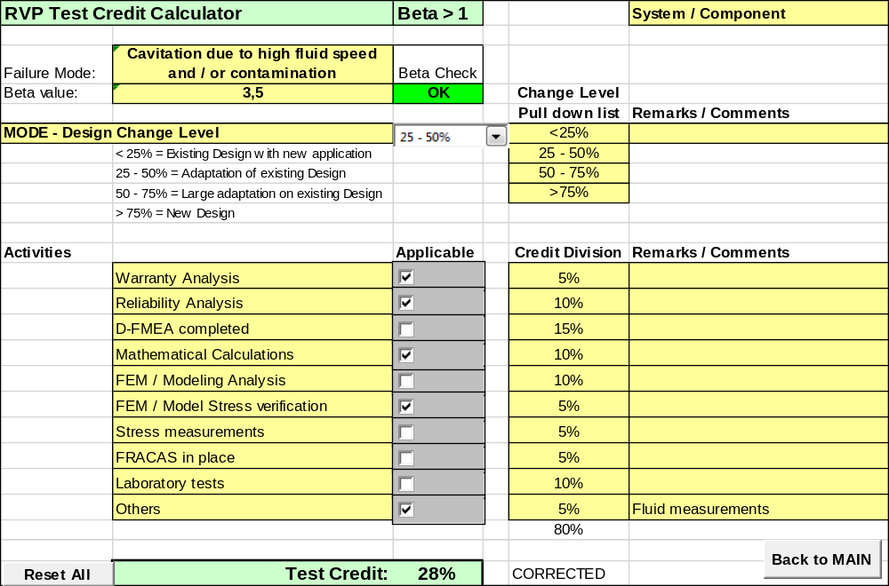
4 – Test Credit Calculator
4 – Test Credit
Design Change Level
Engineering Activities

Slide 24
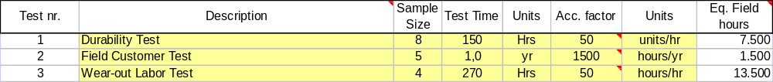
5 – Planned Tests
Notes
2 - Reliability Target
4 – Test Credit
3 - Failure Modes +
Weibull slopes
5 - Planned Test
Equivalent Field hours per Sample

Slide 25
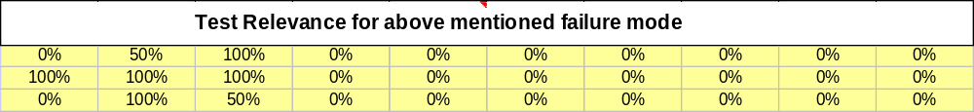
6 – Test Relevance
Notes
2 - Reliability Target
4 – Test Credit
3 - Failure Modes +
Weibull slopes
5 - Planned Test
6 - Test Relevance

Slide 26
6 - Test Relevance
Test Relevance | How Suitable is a Test for the Failure Mode
0 % | Not Suitable at all
25 % | For a Small Portion Suitable
50 % | Partially Suitable
75 % | For a Large Portion Suitable
100 % | Fully Suitable

Slide 27
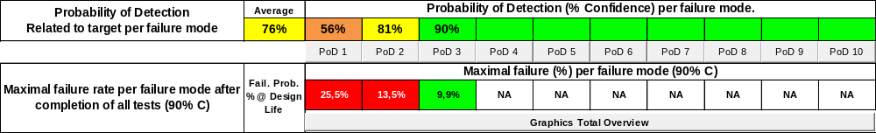
7 - RVP Output - Results
Notes
2 - Reliability Target
4 – Test Credit
3 - Failure Modes +
Weibull slopes
5 - Planned Test
6 - Test Relevance
7 - Results

Slide 28
7 - RVP Detail Output
The Weak Spots of the Risk Mitigation plan

Slide 29


Summary
RVP Tool leads to
Optimal Risk Mitigation Plan
Notes:
TX-SX: Title of presentation
Presenters Name
Page 29

Slide 30
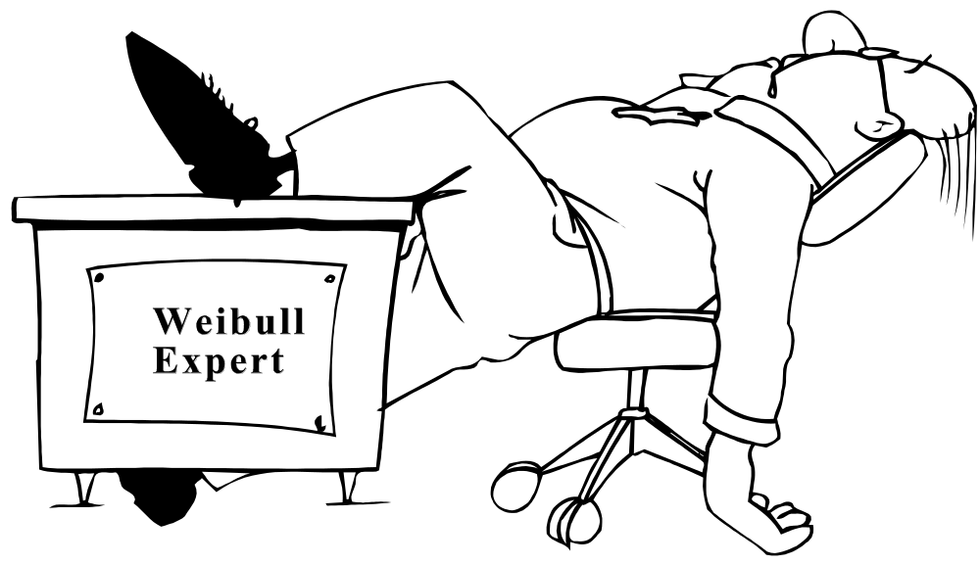
Questions
Safe Zone

Slide 31
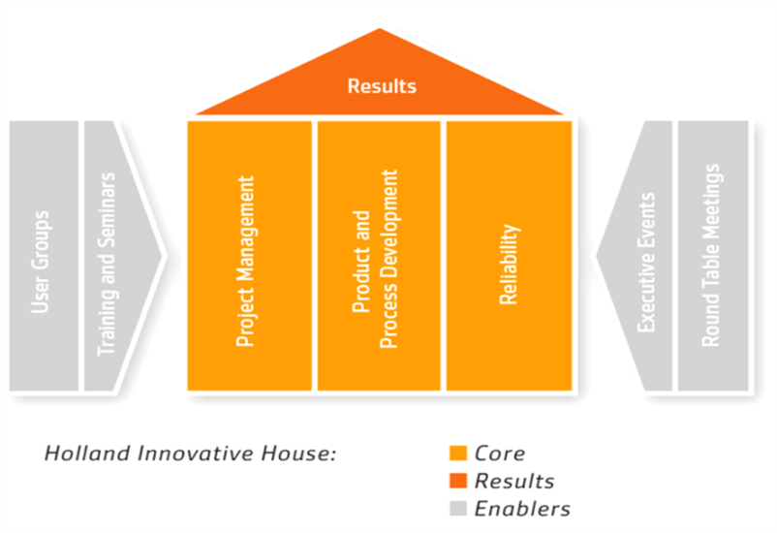

Ing. Ronald Schop
Ronald is the Sr. Director Reliability at Holland Innovative with over 35 years Engineering experiences in the automotive, high-tech, and energy markets. He initiated Reliability Engineering within Product Development at several companies, leading to Design for Reliability and Robust Design in Programs. He developed new Reliability Tools and methods to increase the accuracy of product reliability forecast and verification.
Notes:
TX-SX: Title of presentation
Presenters Name
Page 31

Slide 32
Acronyms
RVP - Reliability Validation Plan
DVP&R - Design Validation Plan & Report
PoD - Probability of Detection
DFMEA - Design Failure Mode & Effect Analysis
R _{T} - Reliability at time “T”
T - Design life or reliability demonstration time
n - Sample size
t _{i} - Total test time of each part
β - Weibull shape parameter or Weibull slope
η - Characteristic Life
C - Statistical confidence level specified
Notes:
TX-SX: Title of presentation
Presenters Name
Page 32

Slide 33
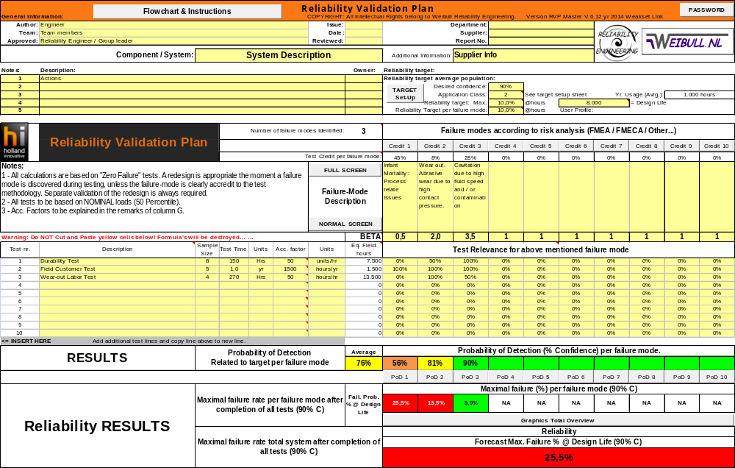
RVP Interface

Slide 34
Information
Book: “The New Weibull Handbook”; Dr. Robert B. Abernethy
Paper: “Two Useful Equations In Reliability Demonstration”; C. Julius Wang
Internet:
www.weibullnews.com
www.weibull.com
www.Weibull.de
www.holland-innovative.nl

