Slide 1

Sample Size and Producer’s Risk in Reliability Testing
Begins at 3:30 PM, Thursday, April 23rd
Ir. Elly Funken
Sr. Reliability Specialist
Holland Innovative

Slide 2
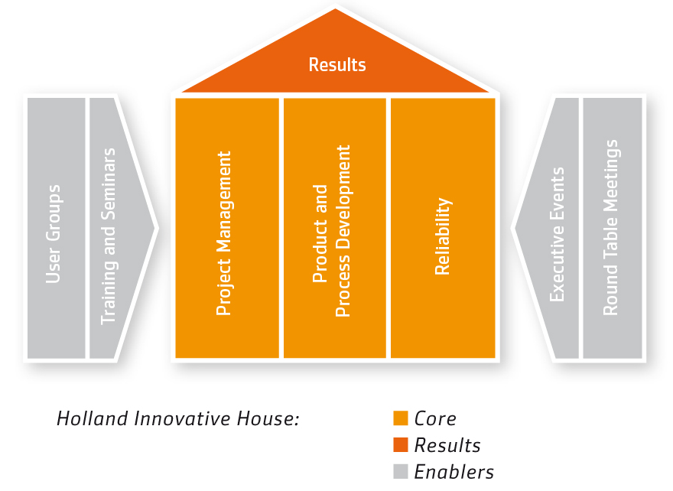
1. Introduction
DfR
DfSS
DfE
Elly Funken
Sr. Reliability Specialist
Reliability competence, Six Sigma knowledge
Process Industries, Automotive, HighTech, Health, Energy, Aerospace
Over 15 years of experiences in Reliability and Functional Safety
HI - Reliability Academy – Trainings, workshops, seminars

Slide 3
1. Introduction
DfR
DfSS
DfE
Holland Innovative
Result-driven Knowledge Center
Reliability Specialists, Product & Process Specialists, Project Managers
HighTech, Automotive, Solar & Energy, Health, Agro & Food
Integration of Reliability & Six Sigma & Project Management Methodologies
Located at High Tech Campus Eindhoven; the Netherlands

Slide 4
Sample Size and Producer’s Risk in Reliability Testing
Introduction 2 min
Reliability testing 3 min
Drivers in Testing for Life 3 min
Determine Sample Size, with case 5 min
Producer's Risk, with case 15 min
Optimize Producer's Risk, with case 15 min
Summary & Conclusions 7 min

Slide 5
2. Reliability Testing
Why stuff fails
and
How stuff fails
and
When stuff fails
Purpose of Testing = Learn

Slide 6
2. Reliability Testing
Reliability-related activities during Product Development
(SLIDE HIDDEN DURING PRESENTATION)
D
M
A
I
C
Monitor
&
DMAIC
Define
Identify
Design
Optimize
Validate
Field validation, Proven process
Tracking, FRACAS
Gather Reliability info
Predecessors, Failure modes, mechanisms
Reliability targets
Concept choices, Functional verification, Robustness
Risk analysis
Functional validation,
Design variants, Manufacturability, Design limits
Validation and test planning
Final design, Tolerances, Operating limits, Qualification
Reliability growth, Meet targets
Validation of corrective actions, Warranty, Production tools
Notes:
Define: Gather Reliab Inform
Identify: Define and allocate targets
Design: risk analysis and DfR
Optimize: Validation and Test planning
Validate: Reliability growth and Meet targets
Monitor and DMAIC: Field validation, Proven process.

Slide 7
2. Reliability Testing
Testing for
Life
Function
Testing for Failure
Robustness
Testing for Design
Design Limits
Optimization
Performance
Reliability Validation
System Prediction
Testing to Verify
Physics of
Failure

Slide 8
2. Reliability Testing
During Product Development
D
M
A
I
C
Monitor
&
DMAIC
Define
Identify
Design
Optimize
Validate
Field Validation
Testing to Verify
Functional verification
Testing for Failure
HALT
Failure Modes & Weak spots
Testing for Design
DOE
Functions & Design Limits
Testing for Life
ALT
Reliability Validation
Reliability Growth
Crow-AMSAA
System Prediction
Testing for Life

Slide 9
3. Drivers in Testing for Life
Design Maturity
Test Equipment
Data Collection, Detection
Technical
Measurement System, R&R
Manufacturing Maturity
Stressors / conditions
Testing for Life
Test goal:
Life or Learn
Failure distribution
Test length, duration
Statistical
Number of acceptable failures
Failure modes, mechanisms
Acceleration
Reliability Target
Confidence
Sample Size
Failure Criteria
Organizational
Scope, boundary
Re-use / destructive
Use cases / Test cases
Delivery Time
Sample Availability
Budget
Illustrative listing, not intended to be complete
Prioritization

Slide 10
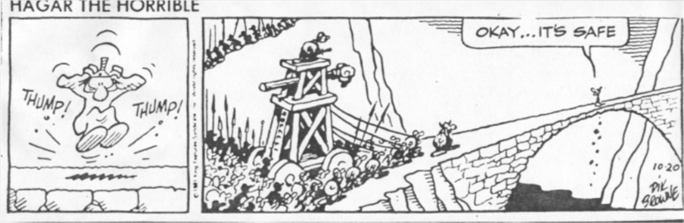
3. Drivers in Testing for Life
Major statistical drivers are:
Test set-up, number of acceptable failures
Reliability target
Failure mode, mechanism, distribution
Test length
Sample Size
Confidence
Testing for Life

Slide 11
4. Determine Sample Size
Focus on determining Sample Size based on Confidence
 | Field R better than Target R | Field R worse than Target R
Pass test | OK Reliable products are accepted | NOK - Confidence Unreliable products are accepted
Not pass test | NOK Reliable products are rejected | OK Unreliable products are rejected

Slide 12

4. Determine Sample Size
How to statistically determine sample size using Confidence ?
Case: Wind Turbine bearings for 2 test set-ups:
  Zero Failure testing
  One or Zero-Failure testing
  Set other major statistical drivers:
    Confidence: Conf = 90%
    Reliability target: R_{TARGET} = 90% at t_{TARGET} = 1000 hours
    Test length: t_{TEST} = 1500 hours
    Failure mode: Wear-out bearings
    Failure distribution: Weibull, Beta β = 2.5
Driver | Zero Failure test | One or Zero Failure test | One or Zero Failure test
# of acceptable failures | 0 | 1
Sample size
Test time per sample | 1,500 hrs | 1,500 hrs
Total test time
Producer’s Risk

Slide 13

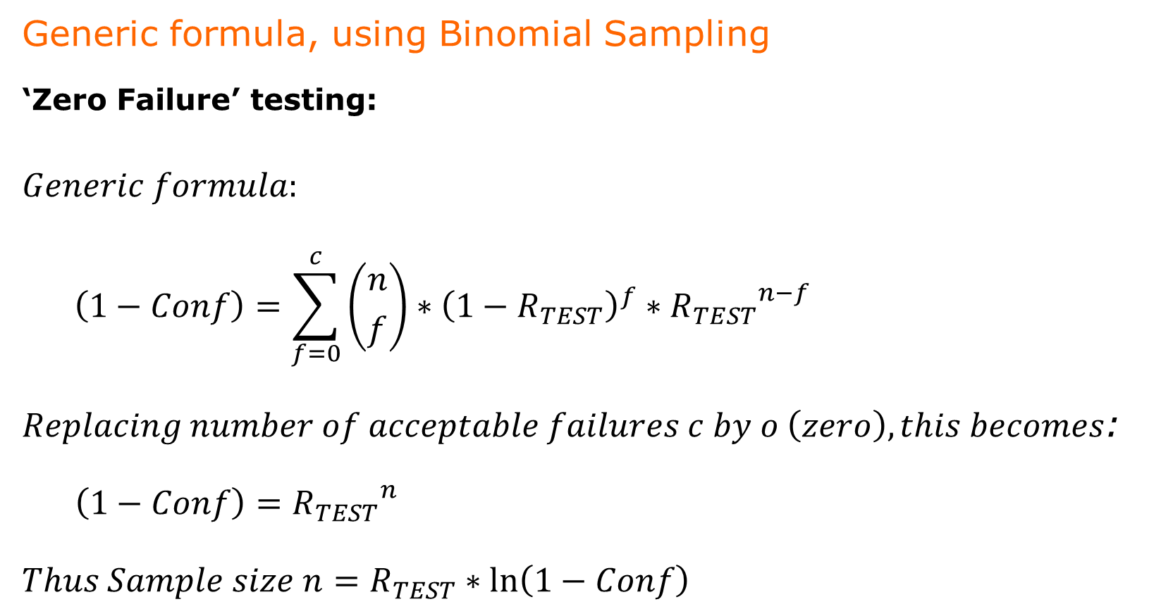
4. Determine Sample size – Zero failure testing
Generic formula, using Binomial Sampling
‘Zero Failure’ testing:
  $$Generic formula:$$
  $$\left(1−Conf\right)=\sum_{f=0}^{c}{\left({n \atop f}\right)}∗{\left(1−R_{TEST}\right)}^{f}∗{R_{TEST}}^{n−f}$$
  $Replacing number of acceptable failures c by o \left(zero\right), this becomes$:
    $$\left(1−Conf\right)={R_{TEST}}^{n}$$
  $$Thus Sample size n=R_{TEST}∗\ln\left(1−Conf\right)$$
$$with c=number of acceptable failures$$

Slide 14
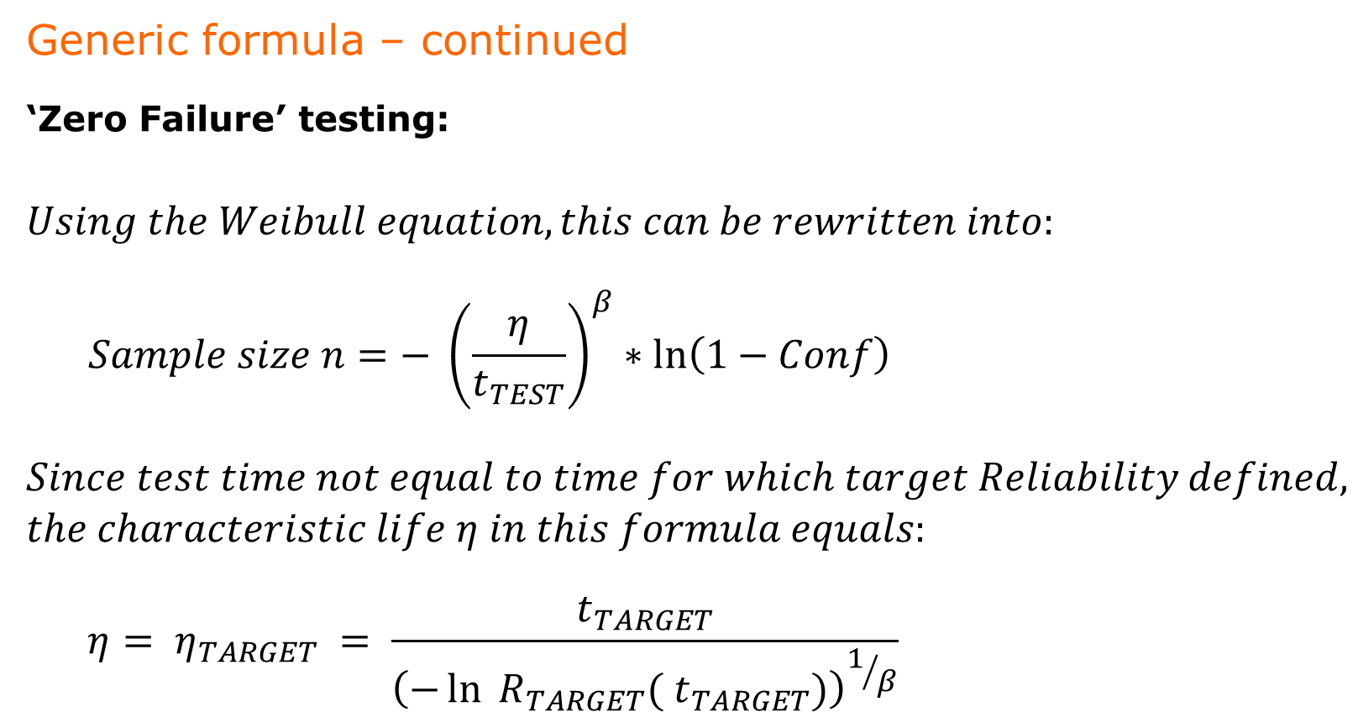
4. Determine Sample size - Zero failure testing
Generic formula – continued
‘Zero Failure’ testing:
  $$Using the Weibull equation, this can be rewritten into:$$
  $$Sample size n=− {\left(\frac{η}{t_{TEST}}\right)}^{β}∗\ln\left(1−Conf\right)$$
  $$Since test time not equal to time for which target Reliability defined, \\ the characteristic life η in this formula equals:$$
  $$η= η_{TARGET} = \frac{t_{TARGET}}{{\left(−\ln{{ R}_{TARGET}({ t}_{TARGET})}\right)}^{1/β}}$$

Slide 15

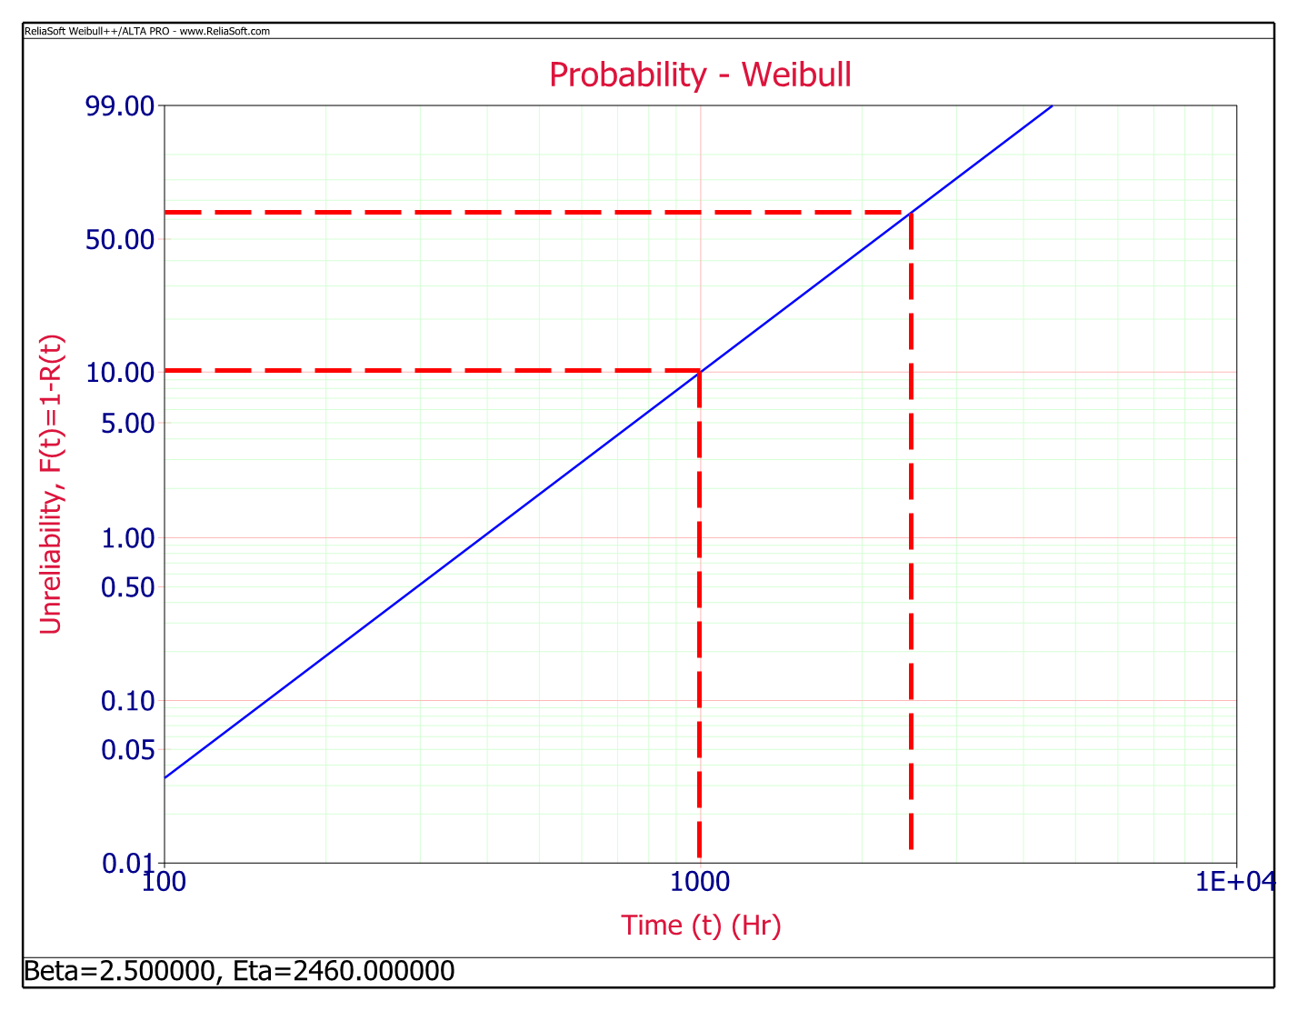
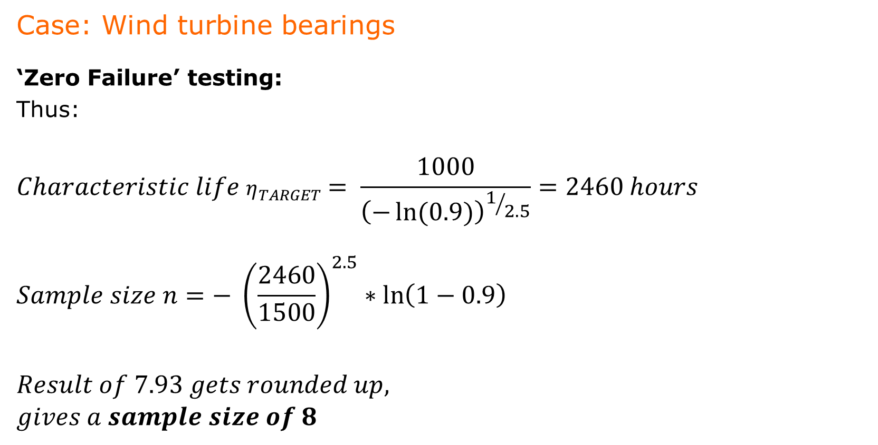
4. Determine Sample size - Zero failure testing
Case: Wind turbine bearings
‘Zero Failure’ testing:
Thus:
  $$Characteristic life η_{TARGET}= \frac{1000}{{\left(−\ln{(0.9)}\right)}^{1/{2.5}}}=2460 hours$$
  $$Sample size n=− {\left(\frac{2460}{1500}\right)}^{2.5}∗\ln\left(1−0.9\right)$$
  $$Result of 7.93 gets rounded up,$$
  $$gives a sample size of 8$$
63.2%
10%
1000
2460

Slide 16
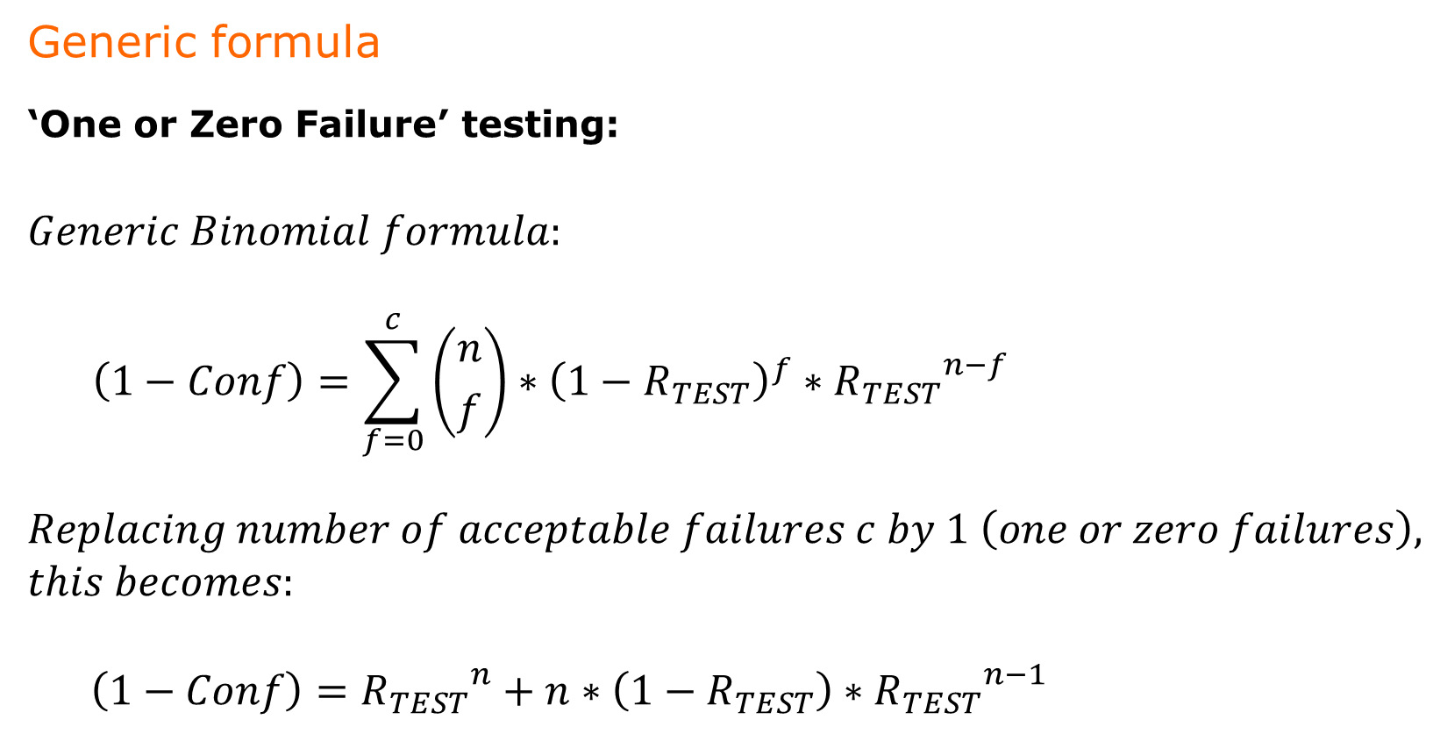
4. Determine Sample size - 1 or 0 failure testing
Generic formula
‘One or Zero Failure’ testing:
  $$Generic Binomial formula:$$
  $$\left(1−Conf\right)=\sum_{f=0}^{c}{\left({n \atop f}\right)}∗{\left(1−R_{TEST}\right)}^{f}∗{R_{TEST}}^{n−f}$$
  $$Replacing number of acceptable failures c by 1 \left(one or zero failures\right), \\ this becomes:$$
  $$\left(1−Conf\right)={R_{TEST}}^{n}+n∗\left(1−R_{TEST}\right)∗{R_{TEST}}^{n−1}$$

Slide 17
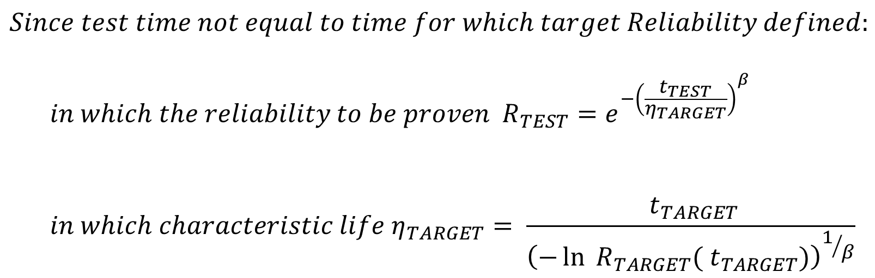
4. Determine Sample size - 1 or 0 failure testing
Generic formula – continued
‘One or Zero Failure’ testing:
  $$Since test time not equal to time for which target Reliability defined:$$
  $$in which the reliability to be proven { R}_{TEST}=e^{−{\left(\frac{t_{TEST}}{η_{TARGET}}\right)}^{β}}$$
  $$in which characteristic life η_{TARGET}= \frac{{ t}_{TARGET}}{{\left(−\ln{{ R}_{TARGET}({ t}_{TARGET})}\right)}^{1/β}}$$

Slide 18
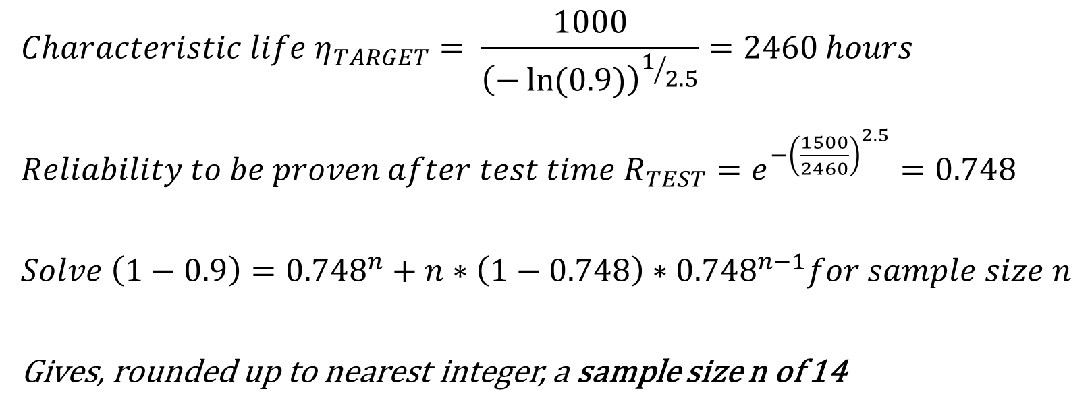
4. Determine Sample size - 1 or 0 failure testing
Case: Wind turbine bearings
‘One or Zero Failure’ testing:
Thus:
  $$Characteristic life η_{TARGET}= \frac{1000}{{\left(−\ln{(0.9)}\right)}^{1/{2.5}}}=2460 hours$$
  ${Reliability to be proven after test time R}_{TEST}=e^{−{\left(\frac{1500}{2460}\right)}^{2.5}}=0.7$48
  $$Solve \left(1−0.9\right)={0.748}^{n}+n∗\left(1−0.748\right)∗{0.748}^{n−1}for sample size n$$
  Gives, rounded up to nearest integer, a sample size n of 14

Slide 19
4. Determine Sample size
First conclusion:
  A One or Zero Failure test requires more samples, with equal test time per sample, than a Zero Failure test to prove a target reliability
Driver | Zero Failure test | One or Zero Failure test | One or Zero Failure test
Number of acceptable failures | 0 | 1
Sample size | 8 | 14
Test time per sample | 1,500 hrs | 1,500 hrs
Total test time | 12,000 hrs | 21,000 hrs
  For identical test time per sample, Failure Mode, Confidence (Consumer's Risk), Target Reliability

Slide 20
5. ‘Forgotten’ driver…Producer’s Risk
    In Testing for Life: statistical driver Confidence
  Confidence = 1 - Consumer's Risk
  Consumer's Risk = Probability that bad products have passed the reliability test
  Example: Confidence level = 0.9 means for a developer:
  “My customer has a 10% probability that he/she receives a bad product, even with my current reliability testing”
What is the risk for the developer, manufacturer ?
The risk of reliable products not passing reliability testing?
Forgotten driver: Producer's Risk

Slide 21
5. Producer's Risk – Rejecting Reliable products
What is Producer's Risk ?
  In DfSS: Probability of rejecting good products
  Good = performing according to specification
  Also called Type I error, α error, False alarm, False negative
Producer's Risk in Reliability & Testing ?
  Probability of not passing the Reliability test - while the products have an actual Reliability higher than proven
  Probability of rejecting Reliable products
    NOTE: Related Term ‘Probability of Passing’ PoP: Producer’s Risk = 1 - PoP

Slide 22
5. Producer's Risk – Rejecting Reliable products
Knowledge required on Actual Reliability in the Field
How to statistically determine Producer's Risk in Testing for Life, for specified Sample Size ?
 | Actual R better than Target R | Actual R worse than Target R
Pass test | OK Reliable products are accepted | Consumer's Risk Unreliable products are accepted
Not pass test | Producer's Risk Reliable products are rejected | OK Unreliable products are rejected

Slide 23
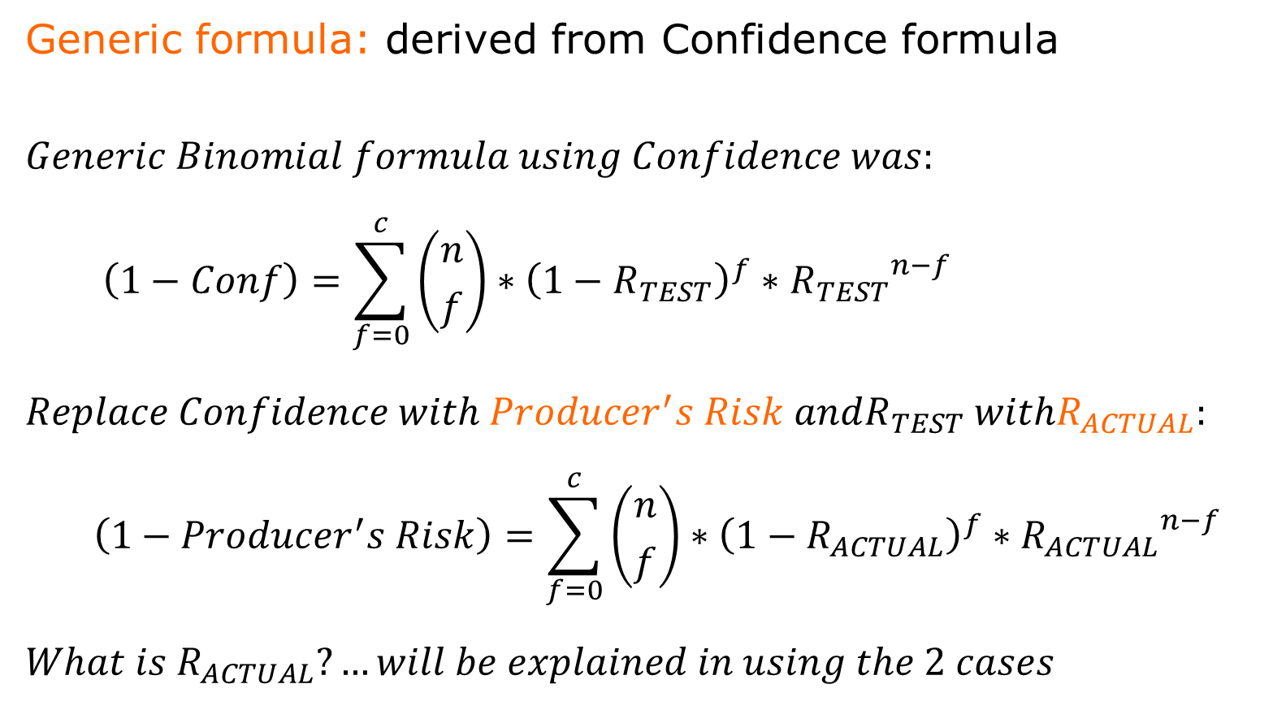
5. Producer's Risk – Rejecting Reliable products
  Generic formula: derived from Confidence formula
  $$Generic Binomial formula using Confidence was:$$
    $$\left(1−Conf\right)=\sum_{f=0}^{c}{\left({n \atop f}\right)}∗{\left(1−R_{TEST}\right)}^{f}∗{R_{TEST}}^{n−f}$$
    $$Replace Confidence with Producer^{′}s Risk andR_{TEST} withR_{ACTUAL}:$$
      $$\left(1−Producer^{′}s Risk\right)=\sum_{f=0}^{c}{\left({n \atop f}\right)}∗{\left(1−R_{ACTUAL}\right)}^{f}∗{R_{ACTUAL}}^{n−f}$$
      $$What is R_{ACTUAL}?…will be explained in using the 2 cases$$

Slide 24
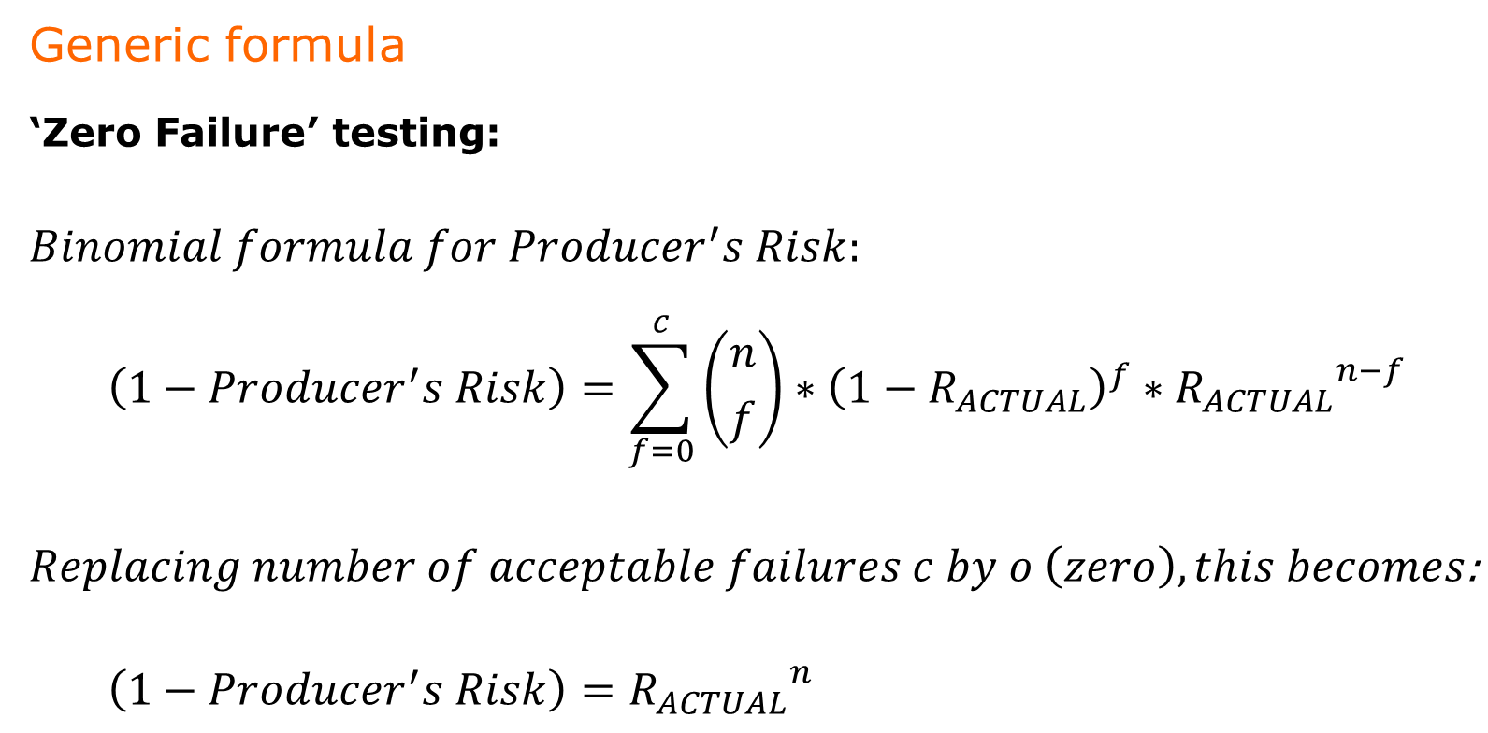
5. Producer's Risk – Zero Failure testing
Generic formula
‘Zero Failure’ testing:
  $$Binomial formula for Producer^{′}s Risk:$$
      $$\left(1−Producer^{′}s Risk\right)=\sum_{f=0}^{c}{\left({n \atop f}\right)}∗{\left(1−R_{ACTUAL}\right)}^{f}∗{R_{ACTUAL}}^{n−f}$$
      $$Replacing number of acceptable failures c by o \left(zero\right), this becomes\text{:}$$
        $$\left(1−Producer^{′}s Risk\right)={R_{ACTUAL}}^{n}$$

Slide 25
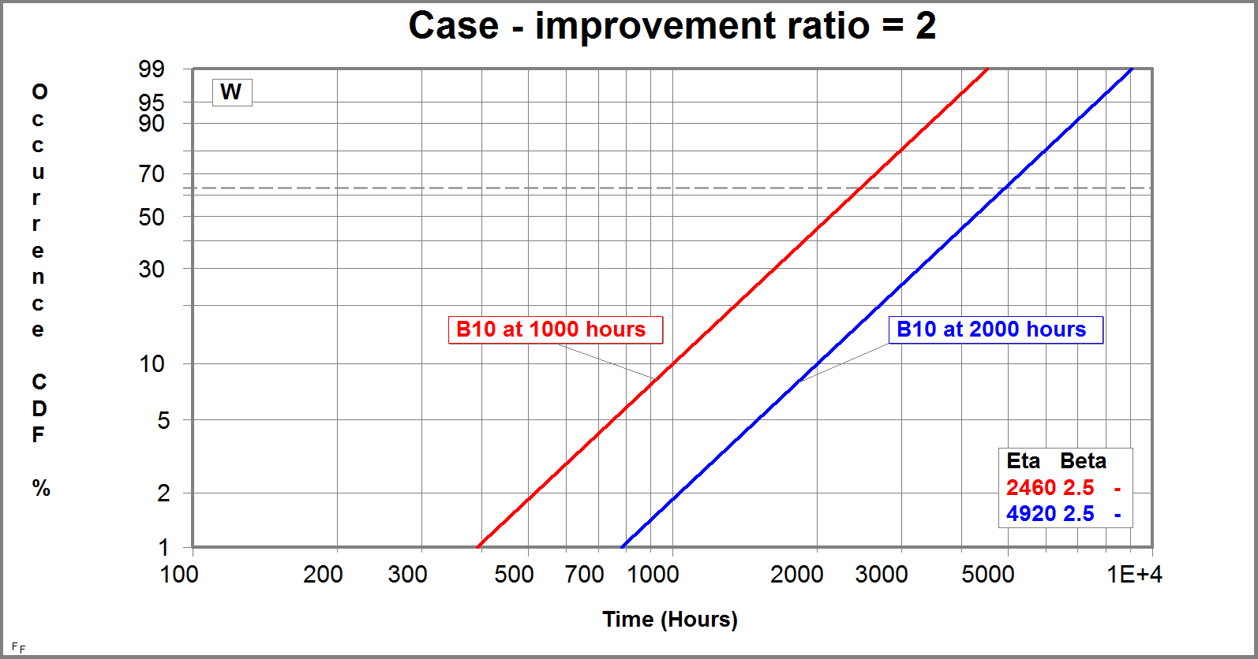
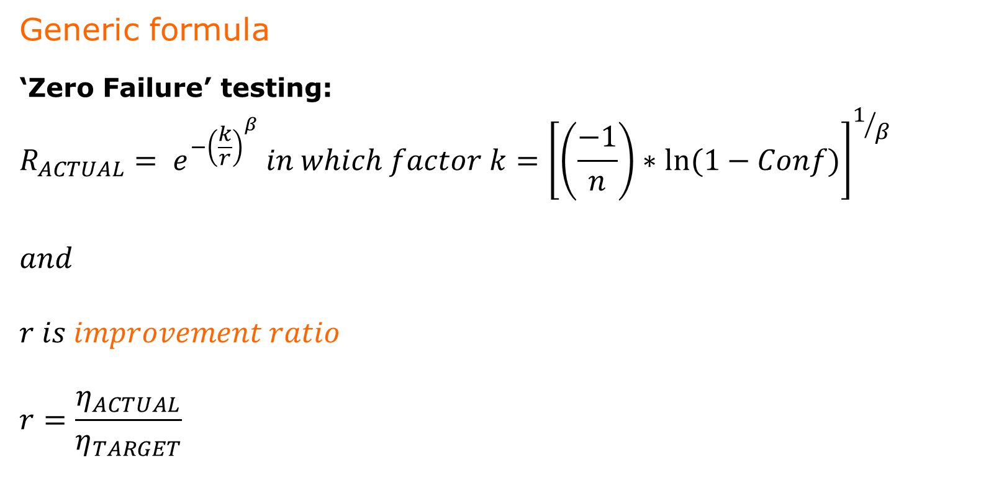
5. Producer's Risk – Zero Failure testing
Generic formula
‘Zero Failure’ testing:
  $$R_{ACTUAL}= e^{{−\left(\frac{k}{r}\right)}^{β}} in which factor k={\left[\left(\frac{−1}{n}\right)∗ln⁡(1−Conf)\right]}^{1/β}$$
  $$and$$
  $$r is improvement ratio$$
  $$r=\frac{η_{ACTUAL}}{η_{TARGET}}$$

Slide 26
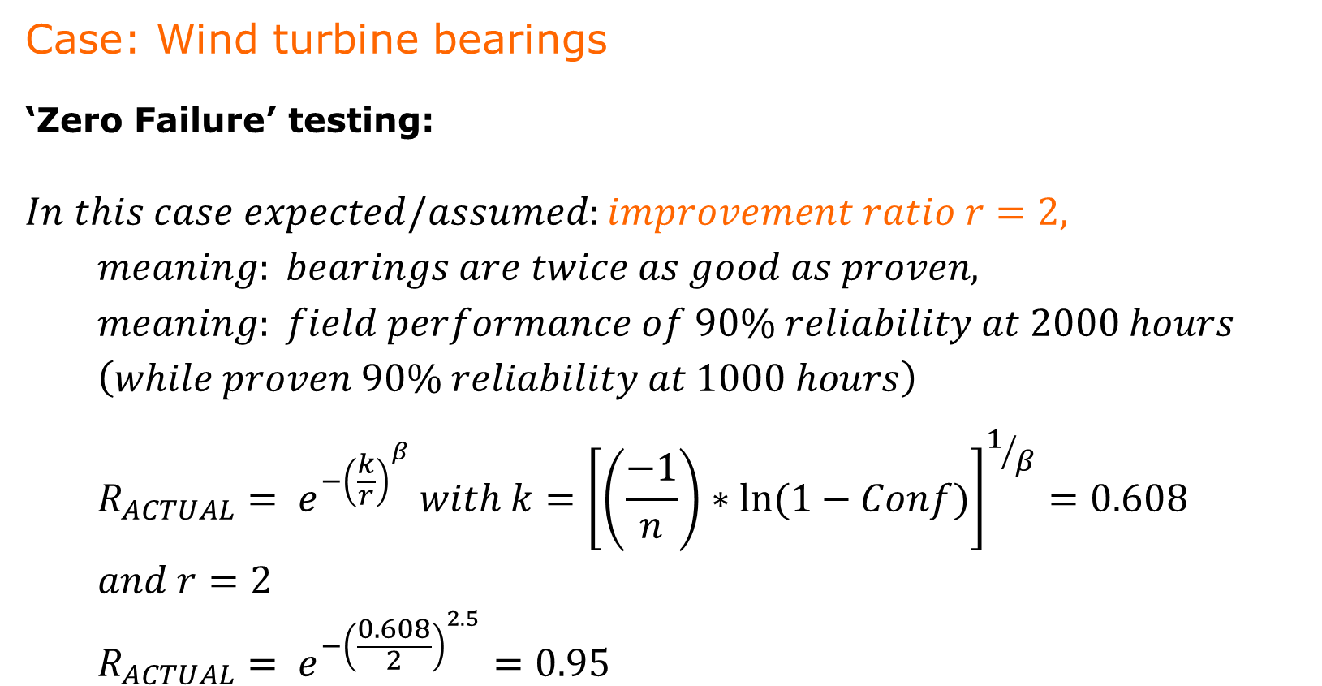
5. Producer's Risk – Zero Failure testing
Case: Wind turbine bearings
‘Zero Failure’ testing:
  $$In this case expected/assumed:improvement ratio r=2,$$
  $$meaning: bearings are twice as good as proven,$$
  $$meaning: field performance of 90\% reliability at 2000 hours$$
  $$\left(while proven 90\% reliability at 1000 hours\right)$$
  $$R_{ACTUAL}= e^{{−\left(\frac{k}{r}\right)}^{β}} with k={\left[\left(\frac{−1}{n}\right)∗ln⁡(1−Conf)\right]}^{1/β}=0.608$$
  $$and r=2$$
  $$R_{ACTUAL}= e^{{−\left(\frac{0.608}{2}\right)}^{2.5}}=0.95$$

Slide 27
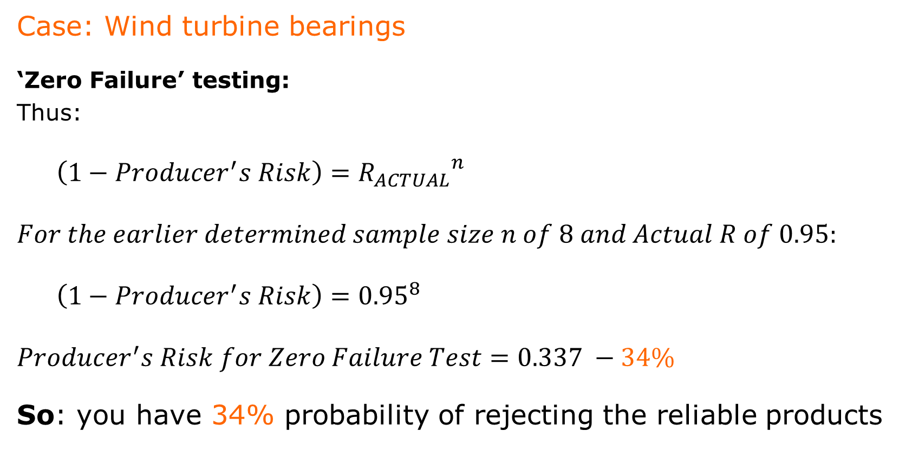
5. Producer's Risk – Zero Failure testing
Case: Wind turbine bearings
‘Zero Failure’ testing:
Thus:
  $$\left(1−Producer^{′}s Risk\right)={R_{ACTUAL}}^{n}$$
  $$For the earlier determined sample size n of 8 and Actual R of 0.95:$$
  $$\left(1−Producer^{′}s Risk\right)={0.95}^{8}$$
  $$Producer^{′}s Risk for Zero Failure Test=0.337 −34\%$$
So: you have 34% probability of rejecting the reliable products

Slide 28
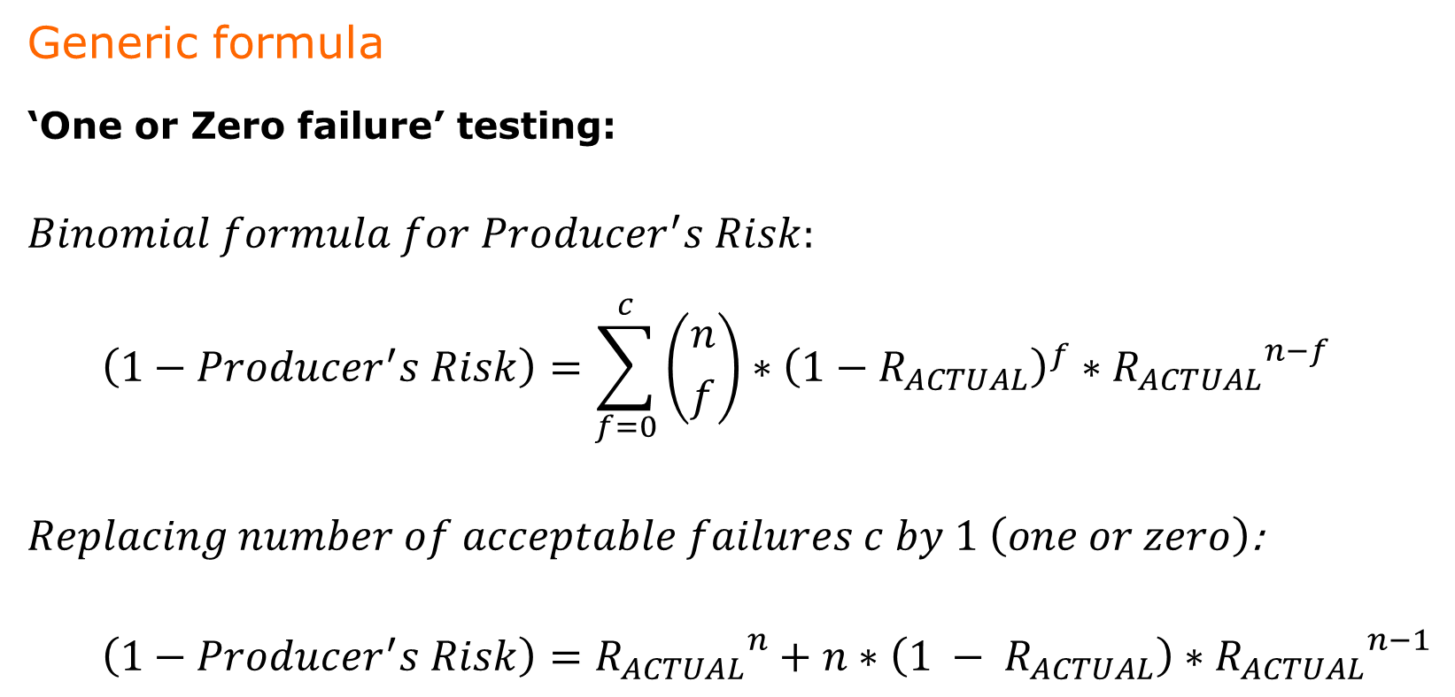
5. Producer's Risk – One or Zero failure testing
Generic formula
‘One or Zero failure’ testing:
  $$Binomial formula for Producer^{′}s Risk:$$
      $$\left(1−Producer^{′}s Risk\right)=\sum_{f=0}^{c}{\left({n \atop f}\right)}∗{\left(1−R_{ACTUAL}\right)}^{f}∗{R_{ACTUAL}}^{n−f}$$
      $$Replacing number of acceptable failures c by 1 \left(one or zero\right)\text{:}$$
        $$\left(1−Producer^{′}s Risk\right)={R_{ACTUAL}}^{n}+n∗\left(1 − R_{ACTUAL}\right)∗{R_{ACTUAL}}^{n−1}$$

Slide 29
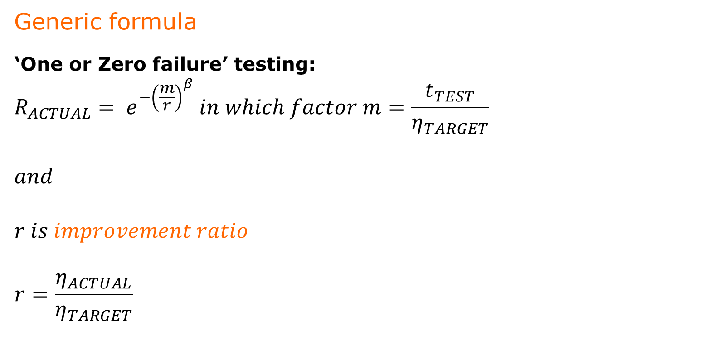
5. Producer's Risk – One or Zero failure testing
Generic formula
‘One or Zero failure’ testing:
  $$R_{ACTUAL}= e^{{−\left(\frac{m}{r}\right)}^{β}} in which factor m=\frac{t_{TEST}}{η_{TARGET}}$$
  $$and$$
  $$r is improvement ratio$$
  $$r=\frac{η_{ACTUAL}}{η_{TARGET}}$$

Slide 30
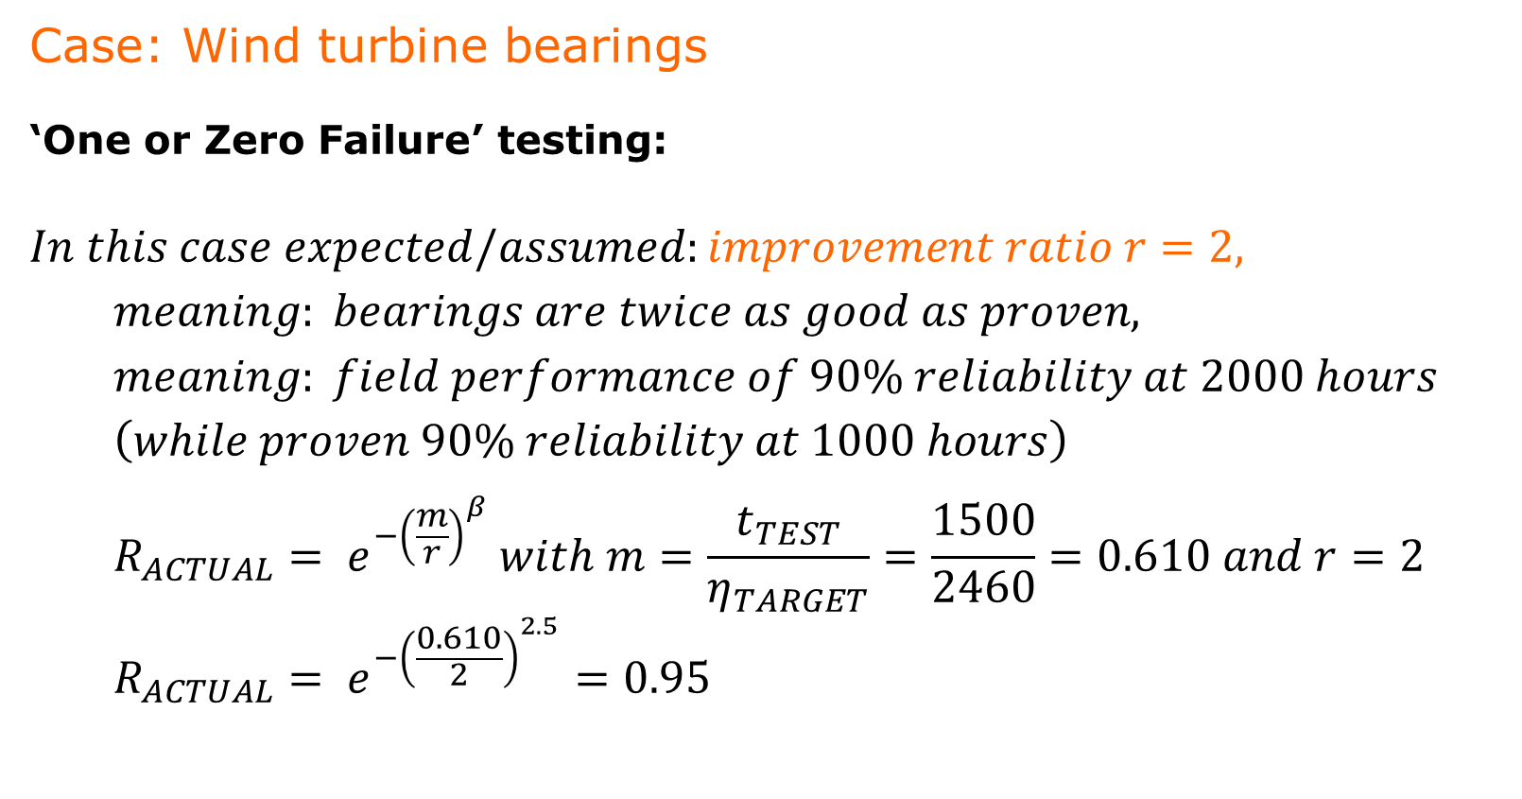
5. Producer's Risk – One or Zero failure testing
Case: Wind turbine bearings
‘One or Zero Failure’ testing:
  $$In this case expected/assumed:improvement ratio r=2,$$
  $$meaning: bearings are twice as good as proven,$$
  $$meaning: field performance of 90\% reliability at 2000 hours$$
  $$\left(while proven 90\% reliability at 1000 hours\right)$$
  $$R_{ACTUAL}= e^{{−\left(\frac{m}{r}\right)}^{β}} with m=\frac{t_{TEST}}{η_{TARGET}}=\frac{1500}{2460}=0.610 and r=2$$
  $$R_{ACTUAL}= e^{{−\left(\frac{0.610}{2}\right)}^{2.5}}=0.95$$

Slide 31
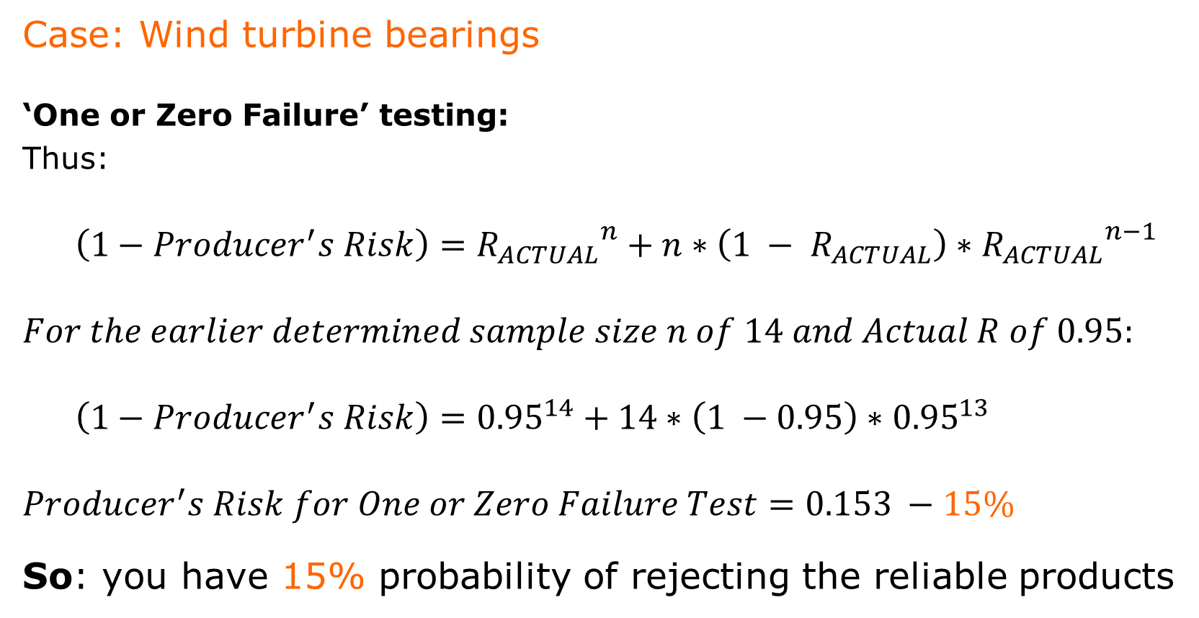
5. Producer's Risk – One or Zero failure testing
Case: Wind turbine bearings
‘One or Zero Failure’ testing:
Thus:
  $$\left(1−Producer^{′}s Risk\right)={R_{ACTUAL}}^{n}+n∗\left(1 − R_{ACTUAL}\right)∗{R_{ACTUAL}}^{n−1}$$
  $$For the earlier determined sample size n of 14 and Actual R of 0.95:$$
  $$\left(1−Producer^{′}s Risk\right)={0.95}^{14}+14∗\left(1 −0.95\right)∗{0.95}^{13}$$
  $$Producer^{′}s Risk for One or Zero Failure Test=0.153 −15\%$$
  So: you have 15% probability of rejecting the reliable products

Slide 32
5. Producer's Risk
  Second Conclusion:
  A One or Zero Failure test has a lower Producer’s Risk than
  a Zero Failure test
  providing the tests both are set up to prove the same target reliability (see first conclusion – requiring more samples)
Driver | Zero Failure test | One or Zero Failure test | One or Zero Failure test
Number of acceptable failures | 0 | 1
Sample size | 8 | 14
Test time per sample | 1,500 hrs | 1,500 hrs
Total test time | 12,000 hrs | 21,000 hrs
Producer’s Risk | 34% | 15%
  For identical test time per sample, Failure Mode, Confidence (Consumer's Risk), target Reliability, AND improvement ratio r

Slide 33

6. Optimize Producer's Risk
Question:
  How to optimize Test for Life on Sample size for specific Consumer's Risk (confidence) and specific Producer's Risk ?
Answer:
  Use the principles of Operating Characteristic Curves to distinguish between Reliability Testing plans.

Slide 34
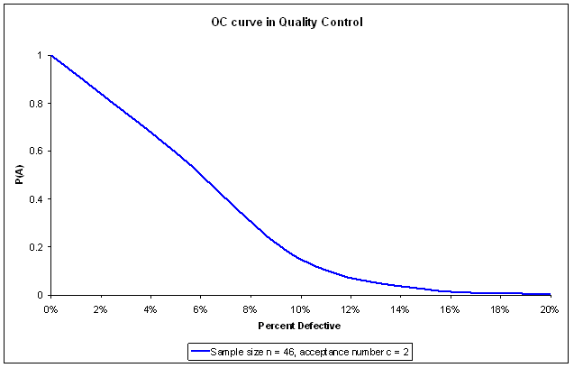
6. Optimize Producer's Risk – OC curves
Operating Characteristic curves (OC curves)
  Derived from Power curves in statistical sampling
  In Quality Control: Relationship between Probability of Acceptance P(A) and Percent Defective in a lot
Illustrative OC curve in Quality Control
For specific Sampling Plan

Slide 35
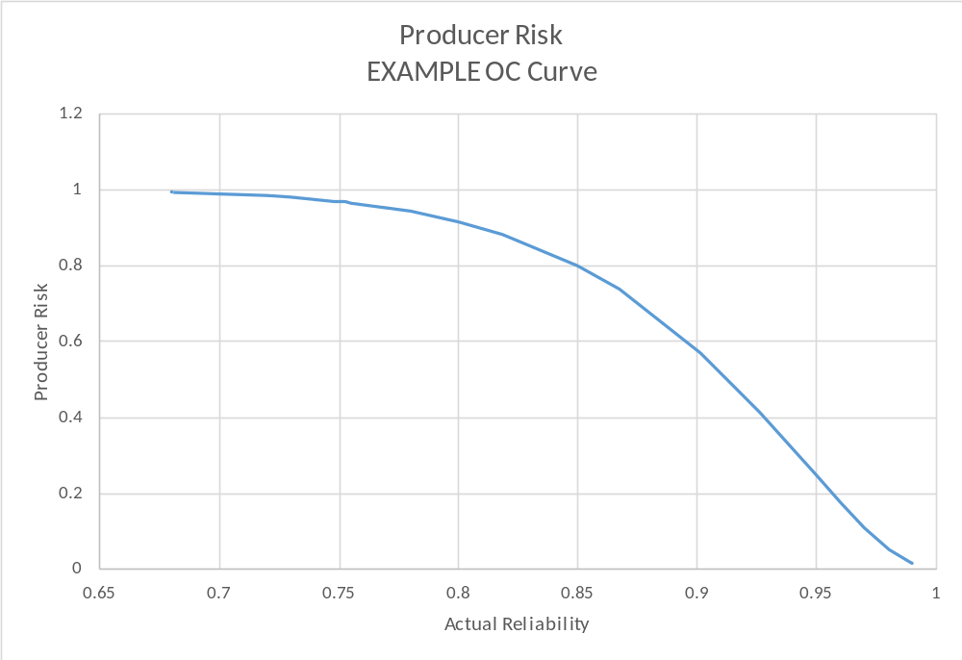
6. Optimize Producer's Risk – OC curves
Operating Characteristic Curves in Reliability
Not ‘Probability of Acceptance’ versus ‘Percentage Defective’, but:
‘Probability of Passing’ versus ‘Reliability Metric’, or, for example,
‘Producer’s Risk’ versus ‘Actual Reliability’

Slide 36

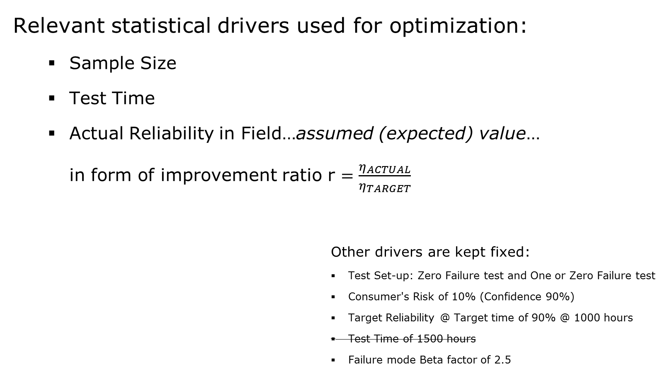
6. Optimize Producer's Risk – Drivers
Relevant statistical drivers used for optimization:
  Sample Size
  Test Time
  Actual Reliability in Field…assumed (expected) value…
  in form of improvement ratio r $=\frac{η_{ACTUAL}}{η_{TARGET}}$
  Other drivers are kept fixed:
    Test Set-up: Zero Failure test and One or Zero Failure test
    Consumer's Risk of 10% (Confidence 90%)
    Target Reliability @ Target time of 90% @ 1000 hours
    Test Time of 1500 hours
    Failure mode Beta factor of 2.5

Slide 37
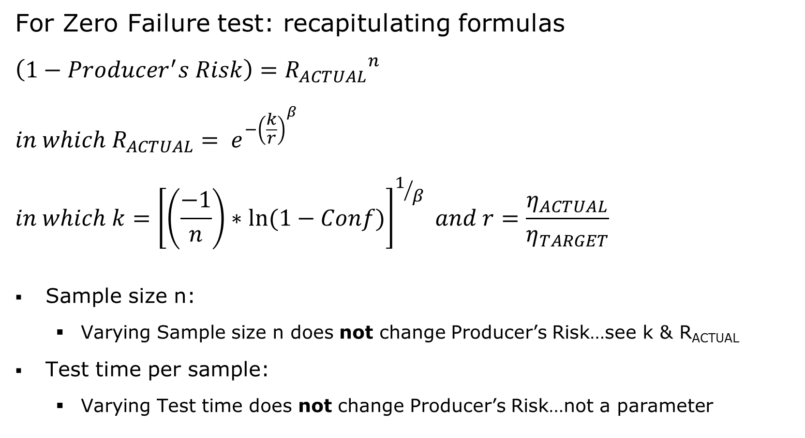
6. Optimize Producer's Risk – Zero Failure test
For Zero Failure test: recapitulating formulas
  $$\left(1−Producer^{′}s Risk\right)={R_{ACTUAL}}^{n}$$
  $$in which R_{ACTUAL}= e^{{−\left(\frac{k}{r}\right)}^{β}}$$
  $$in which k={\left[\left(\frac{−1}{n}\right)∗ln⁡(1−Conf)\right]}^{1/β} and r=\frac{η_{ACTUAL}}{η_{TARGET}}$$
Sample size n:
  Varying Sample size n does not change Producer’s Risk…see k & R_{ACTUAL}
Test time per sample:
  Varying Test time does not change Producer’s Risk…not a parameter

Slide 38
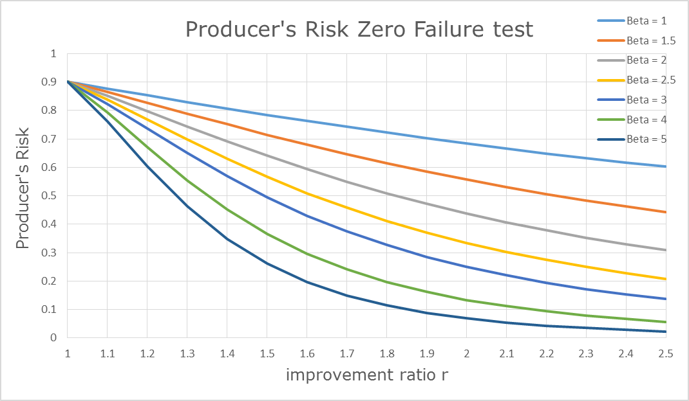
6. Optimize Producer's Risk – Zero Failure test
Only drivers influencing Producer’s Risk in Zero failure test:
  Improvement ratio r
  Weibull Beta factor β (failure mode)
ILLUSTRATIVE
34%
β=2.5
13%
β=4
For identical sample size and test time per sample
r=2

Slide 39
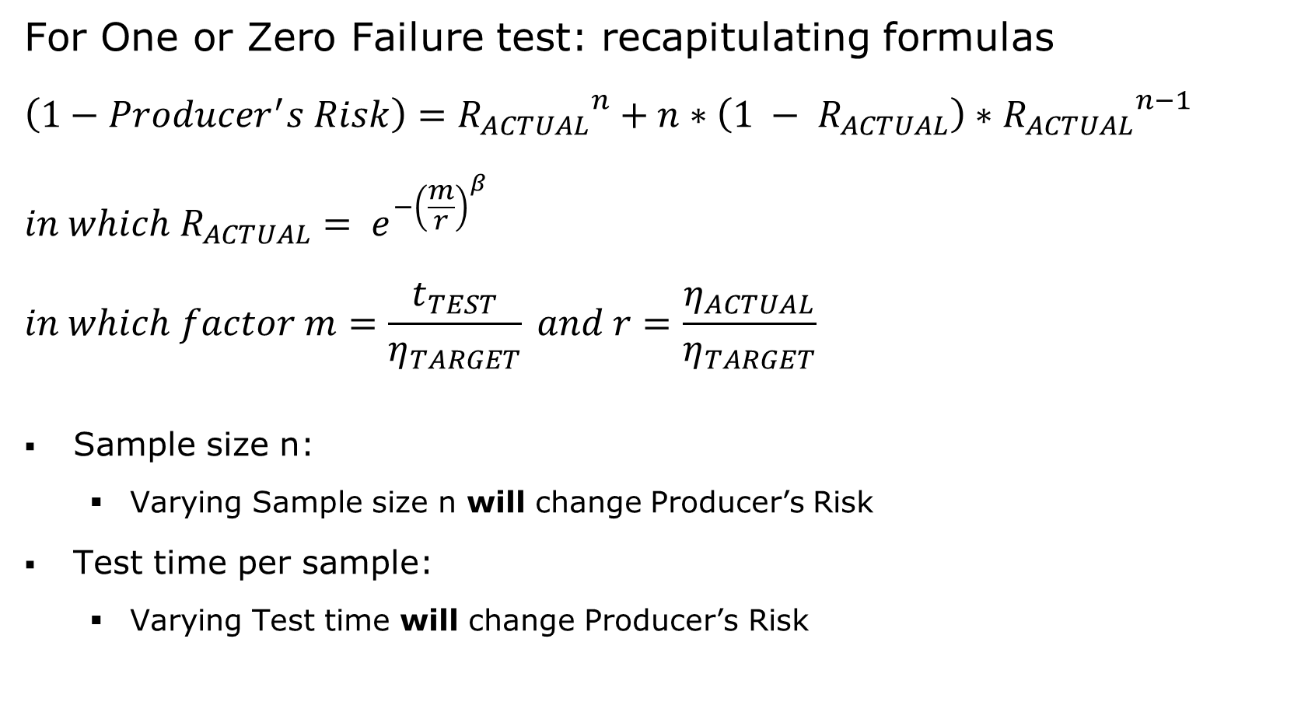
6. Optimize Producer's Risk – 1 or 0 Failure test
For One or Zero Failure test: recapitulating formulas
  $$\left(1−Producer^{′}s Risk\right)={R_{ACTUAL}}^{n}+n∗\left(1 − R_{ACTUAL}\right)∗{R_{ACTUAL}}^{n−1}$$
  $$in which R_{ACTUAL}= e^{{−\left(\frac{m}{r}\right)}^{β}}$$
  $$in which factor m=\frac{t_{TEST}}{η_{TARGET}} and r=\frac{η_{ACTUAL}}{η_{TARGET}}$$
Sample size n:
  Varying Sample size n will change Producer’s Risk
Test time per sample:
  Varying Test time will change Producer’s Risk

Slide 40
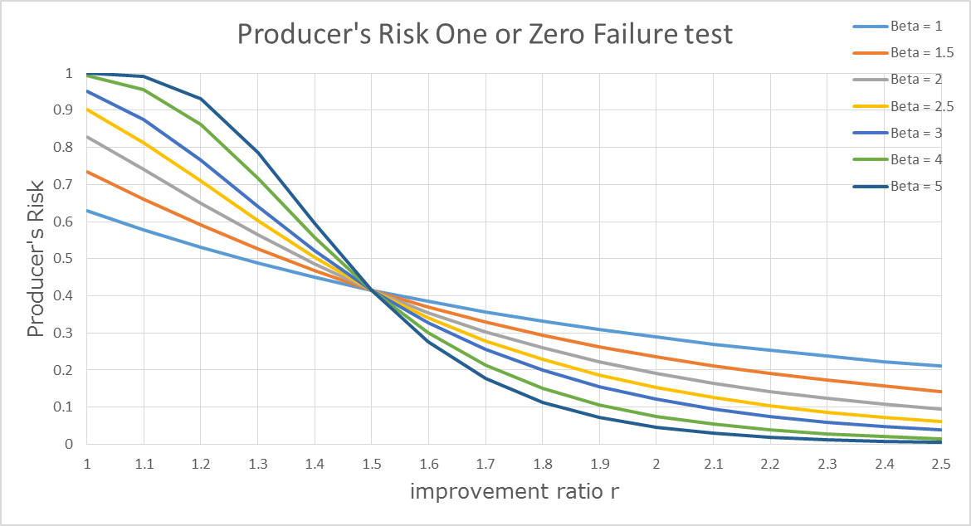
6. Optimize Producer's Risk – 1 or 0 Failure test
Drivers influencing Producer’s Risk in One or Zero failure test:
  Sample size n & Test time
  Improvement ratio r
  Weibull Beta factor β (failure mode)
ILLUSTRATIVE
15%
β=2.5
7.5%
β=4
For identical sample size and test time per sample
r=2

Slide 41
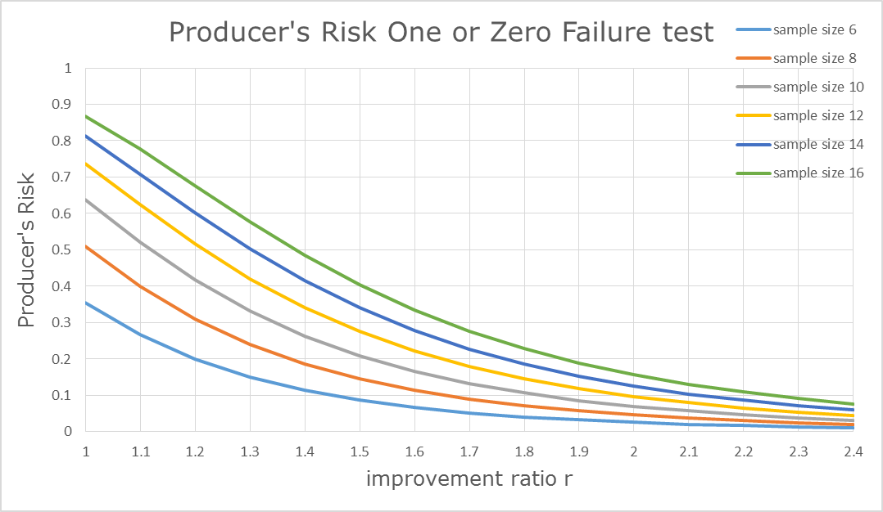
6. Optimize Producer's Risk – 1 or 0 Failure test
Various Sample sizes for One or Zero Failure test
So, how to lower your Producer's Risk ?
ILLUSTRATIVE
More samples
For identical Beta factor and test time per sample

Slide 42
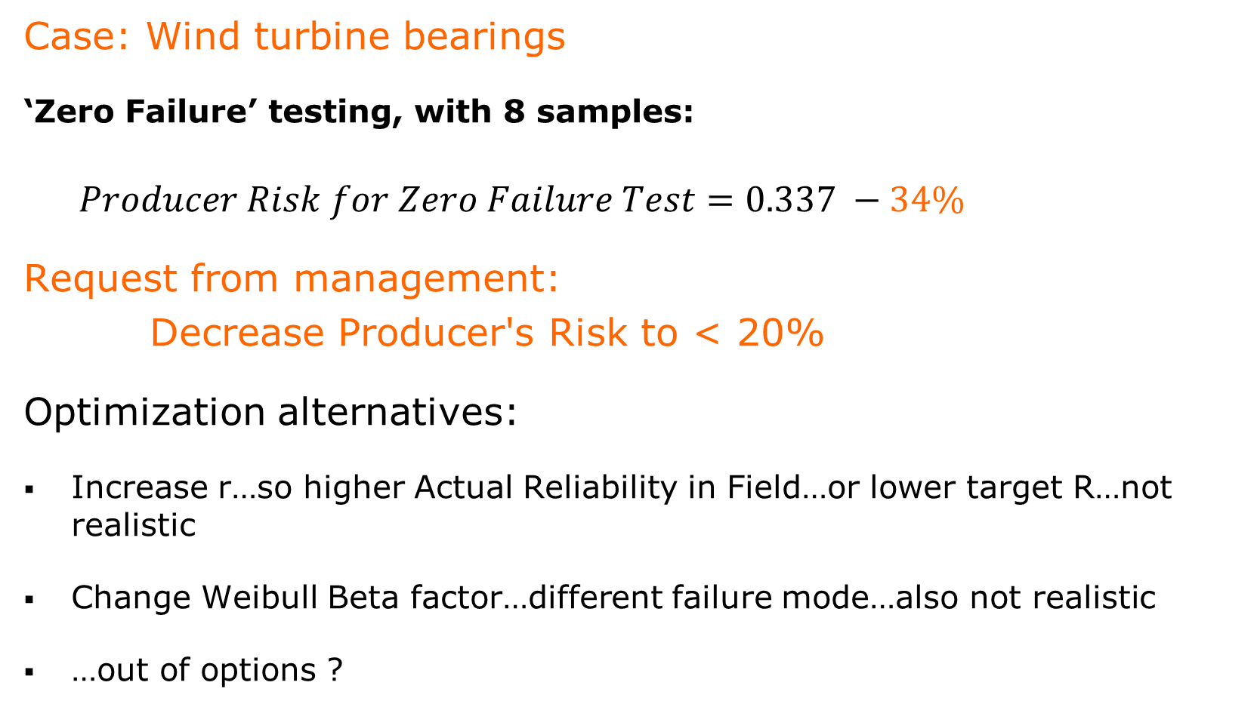
6. Optimize Producer's Risk – Zero Failure test
Case: Wind turbine bearings
‘Zero Failure’ testing, with 8 samples:
  $$Producer Risk for Zero Failure Test=0.337 −34\%$$
Request from management:
Decrease Producer's Risk to < 20%
Optimization alternatives:
Increase r…so higher Actual Reliability in Field…or lower target R…not realistic
Change Weibull Beta factor…different failure mode…also not realistic
…out of options ?

Slide 43
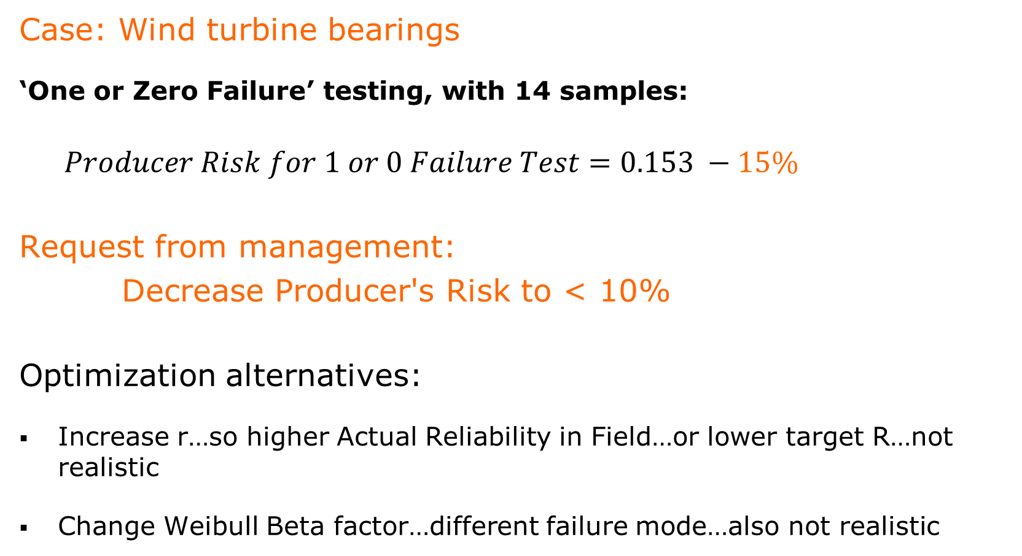
6. Optimize Producer's Risk – 1 or 0 failure test
Case: Wind turbine bearings
‘One or Zero Failure’ testing, with 14 samples:
  $$Producer Risk for 1 or 0 Failure Test=0.153 −15\%$$
Request from management:
Decrease Producer's Risk to < 10%
Optimization alternatives:
Increase r…so higher Actual Reliability in Field…or lower target R…not realistic
Change Weibull Beta factor…different failure mode…also not realistic

Slide 44
6. Optimize Producer's Risk – 1 or 0 failure test
Case: Wind turbine bearings
‘One or Zero Failure’ testing:
So, let’s try:
‘Decrease Sample Size’…from 14 to 10
However…
Consequence:
To prove target R, test time per sample
has to increase to 1725 hrs
Consequence:
Total test time: from 14x1500 = 21000 hrs
to 10x1725 = 17250 hrs

Slide 45
6. Optimize Producer's Risk – 1 or 0 failure test
Case: Wind turbine bearings - continued
‘One or Zero Failure’ testing:
Consequence could be:
Producer's Risk reduces from 15% to 9%
However:
improvement ratio r has to increase to 2.3 !
Independent of change in sample size and test time per sample
For lower Producer’s Risk: higher actual R in Field expected – realistic ?
For same target R: decrease in Total test time and less samples possible

Slide 46
6. Optimize Producer's Risk – Zero Failure test
Case: Wind turbine bearings – return to 0 failure test
Lower Producer’s Risk by changing test set-up:
From ‘Zero Failure’ test to ‘One or Zero Failure’ test
for same sample size of 8
Consequence:
Test time per sample has to increase to prove target R
To prove target R90, test time per sample has to increase to 1,900 hrs
Total test time: from 8 x 1,500 = 12,000 hrs to 7 x 1,900 = 13,300 hrs, providing these 7 samples have not failed
Consequence: Producer’s Risk of 34% decreases to 15%

Slide 47
6. Optimize Producer's Risk
Third Conclusion:
  Reducing Producer’s Risk requires:
  Higher improvement ratio r, or…
  Different failure mode (Weibull Beta)
  Different test set-up; increase number of acceptable failures
Driver | Zero Failure test | One or Zero Failure test | One or Zero Failure test
Number of acceptable failures | 0 | 1 | 1
Sample size | 8 | 14 | 8
Test time per sample | 1,500 hrs | 1,500 hrs | 1,900 hrs
Total test time | 12,000 hrs | 21,000 hrs | 15,200 (13,300) hrs
Producer’s Risk | 34% | 15% | 15%
  For identical Confidence (Consumer's Risk), Failure Mode (Weibull Beta), target Reliability, improvement ratio r

Slide 48

7. Summary – Sample Size & Producer's Risk
Major statistical drivers for Sample size were:
  Test set-up, number of acceptable failures
  Confidence, Consumer’s Risk
  Reliability target
  Test length
  Failure distribution & Failure mode
Forgotten Driver: Producer's Risk !
Risk of rejecting reliable products

Slide 49
7. Summary – Sample Size & Producer's Risk
Producer's Risk – Drivers & Optimization:
Improvement ratio r:
  The closer the ratio r to 1, the higher the Producer's Risk
  Decreasing Producer’s Risk by;
  Increasing Actual Reliability in Field (challenging), or…
  Proving a lower Target Reliability (higher field failure rate)
Sample Size n and Test time per sample:
  No direct effect – have to prove target Reliability
Failure mode (Weibull Beta):
  Different failure mode – not realistic
Number of Acceptable Failures:
  More failures acceptable (for fixed n) can lower Producer's Risk

Slide 50

7. Conclusions – Sample Size & Producer's Risk
  Producer’s Risk is a relevant driver in testing !
  Managing Producer’s Risk:
  Decrease Producer’s Risk by
  Increasing number of acceptable failures, with identical sample size, while…
  Increasing Test time per sample and Slightly increasing total Test time
  For identical Target Reliability and improvement ratio r and Failure mode Beta

Slide 51

Questions
Thank you for your attention.
Do you have any questions?
Test
Expert

Slide 52

Ir. Elly Funken
Elly Funken is a Sr. Reliability and Functional Safety Specialist at Holland Innovative with extensive experiences in process industries on functional safety, and on reliability in the high-tech, automotive, energy, health, and aerospace markets. She has been successful in achieving and improving reliability of complex and innovative products for companies like Honeywell, DAF Trucks, ASML, B/E Aerospace, Philips HealthTech, Punch Powertrain, and Netbeheer Nederland.

Slide 53
More reading
The Certified Reliability Engineer Handbook, Second Edition, D. Benbow, H. Broome, 2013, ASQ Quality Press
Reliability and Life Testing Handbook, volume 2, D. Kececioglu, 2002, DESTech publications
Applied Statistics and Probability for Engineers, Sixth Edition, D. Montgomery, G. Runger, 2013
Practical Reliability Engineering, Fifth Edition, Patrick D.T. O’Connor, 2012
New Weibull Handbook, Fifth Edition, B. Abernethy, 2010
Weibull.com
Determining the Right Sample Size for Your Test: Theory and Application, H. Guo, E. Pohl, A. Gerokostopoulos, 2013, Annual Reliability and Maintainability Symposium
ASQ Reliability Division webinars

