Slide 1

The power of Crow-AMSAA analysis
Begins at: X:XX AM, XXXday, June Xth
Dorien Lutgendorf
Notes:
Welkom
Who knows what dirty data is?

Slide 2
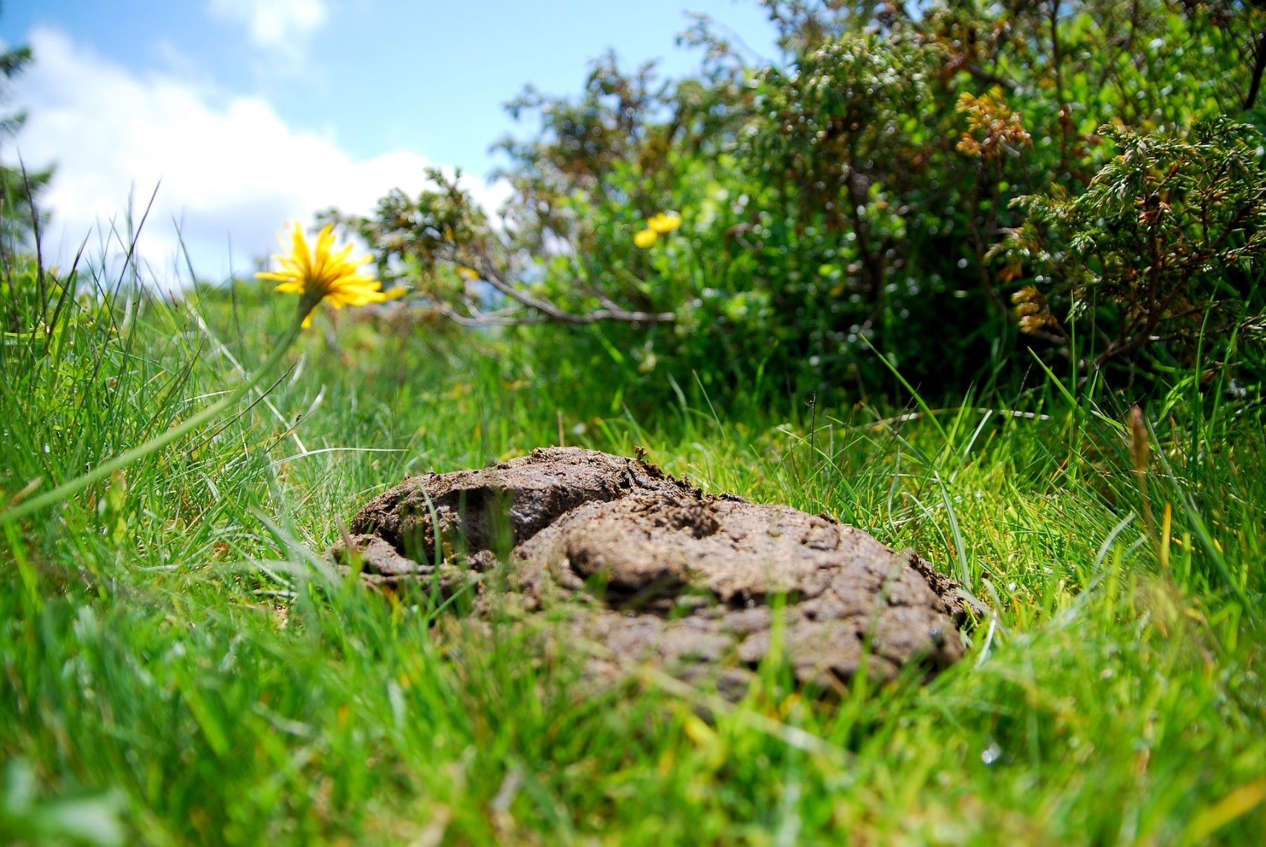
‘Dirty’ data
Notes:
Actual data is like poo. Lot of information is inside but on first sight is seems useless and dirty.
Use the coming 30min to show you how Crow-AMSAA can enrich your engineering toolbox and can make seemlessly unusefull data still powerfull.
I will take you along three practical applications with different problemetics and show you how ca was contributing.

Slide 3
Agenda
Case 1
Performance of a End-Of-Line Tester
Case 2
Planning of a revision of furnace installation
Case 3
Field replacement costs forecast verification

Slide 4
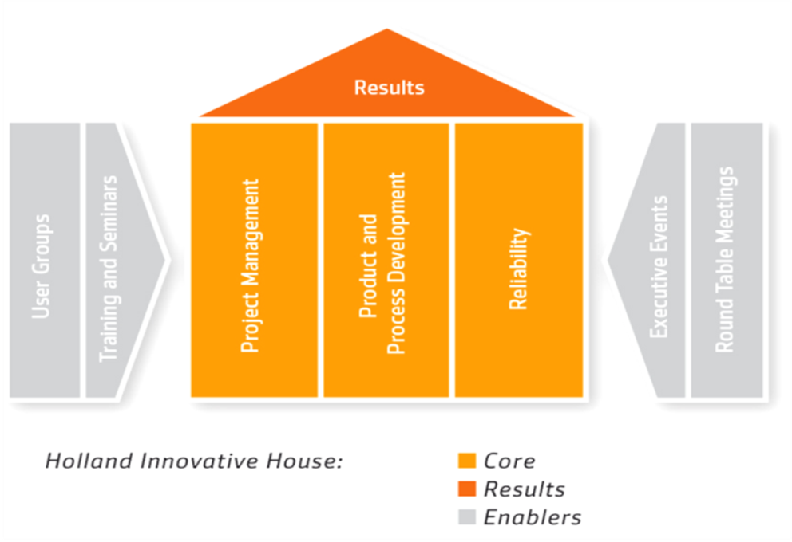
Introduction
Dorien Lutgendorf
Reliability Specialist
Holland Innovative
Result-driven Knowledge Center
Project Managers, Product & Process Specialists, Reliability Specialists
HighTech, Automotive, Solar & Energy, Health, Agro & Food
Integration of Six Sigma & Reliability Methodologies
Located at High Tech Campus Eindhoven; the Netherlands
Open Innovation and Collaboration
Notes:
Introduce myself
Are there people who are already familiar with the trend analysis technique crow-amsaa?
------------------------
Quit a simple methodology who was developed by Dr. Crow and is also referred to as Duane model or NHPP, power law.
First developed at the U.S. Army Materiel Systems Analysis Activity by Dr. Larry Crow:​
He proposed using a Non-Homogeneous Poisson Process (NHPP)

Slide 5
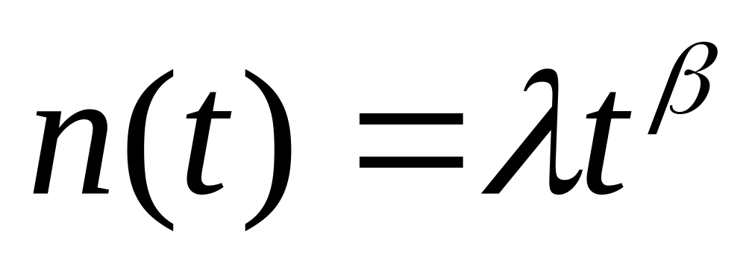
Crow-AMSAA trend analysis method
t time
N(t) Cumulative failures at t
β shape or Reliability Growth parameter
λ scale parameter, intersection y-axis
Notes:
First developed at the U.S. Army Materiel Systems Analysis Activity by Dr. Larry Crow:​
He proposed using a Non-Homogeneous Poisson Process (NHPP) with Weibull intensity function; Cumulative number of failures at t, n(t).​
​On Log-Log paper, the graph of cumulative failure-rate versus cumulative test time is linear.
The basic formulae is: ….
It is a robust technique which is very suited and has a wide range of applications. To check if there is Reliability growth, tracking significant events for management, predicting warranty clams, checking batch effects.
And it can deal with dirty data. Dirty data being for instance:
Incomplete
Multiple failure modes
Missing portions of data
In general each Crow-AMSAA analysis deals with a few steps:

Slide 6
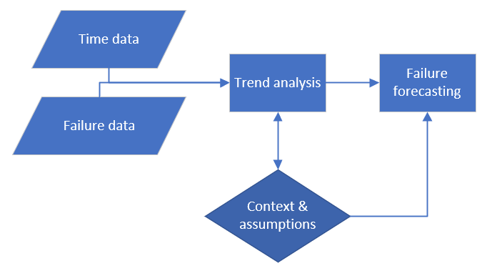
General flow
Notes:
It als starts with the data. Which is often in a certain way dirty. Or unjustified considered not interesting
For the analysis always a few assumptions or context related choices need to made. Definition of what type of failure/trend interesting.
Trend analyis follows.
The customers are most of the time interesting in the failure rate to expect and the number of failure to expect in the future. The three case I am going to discuss also. They are real analyses done for three multinationals. Because of confidentiality the names of company product and values or alternated or anomynised.

Slide 7

Case 1:
Performance of a End-Of-Line Tester

Slide 8


Aim of the analysis
Notes:
Data available in files per months
Datum format is bit inconsistent
Period 3/1/2018 – 25/2/2018. Missings days:
6 jan
19-21 jan
11-24 feb
All 3 FTs are serving 1 production line of appliances.
FT1 starts first, others 2 are scaled up when needed (overflow principe)

Slide 9
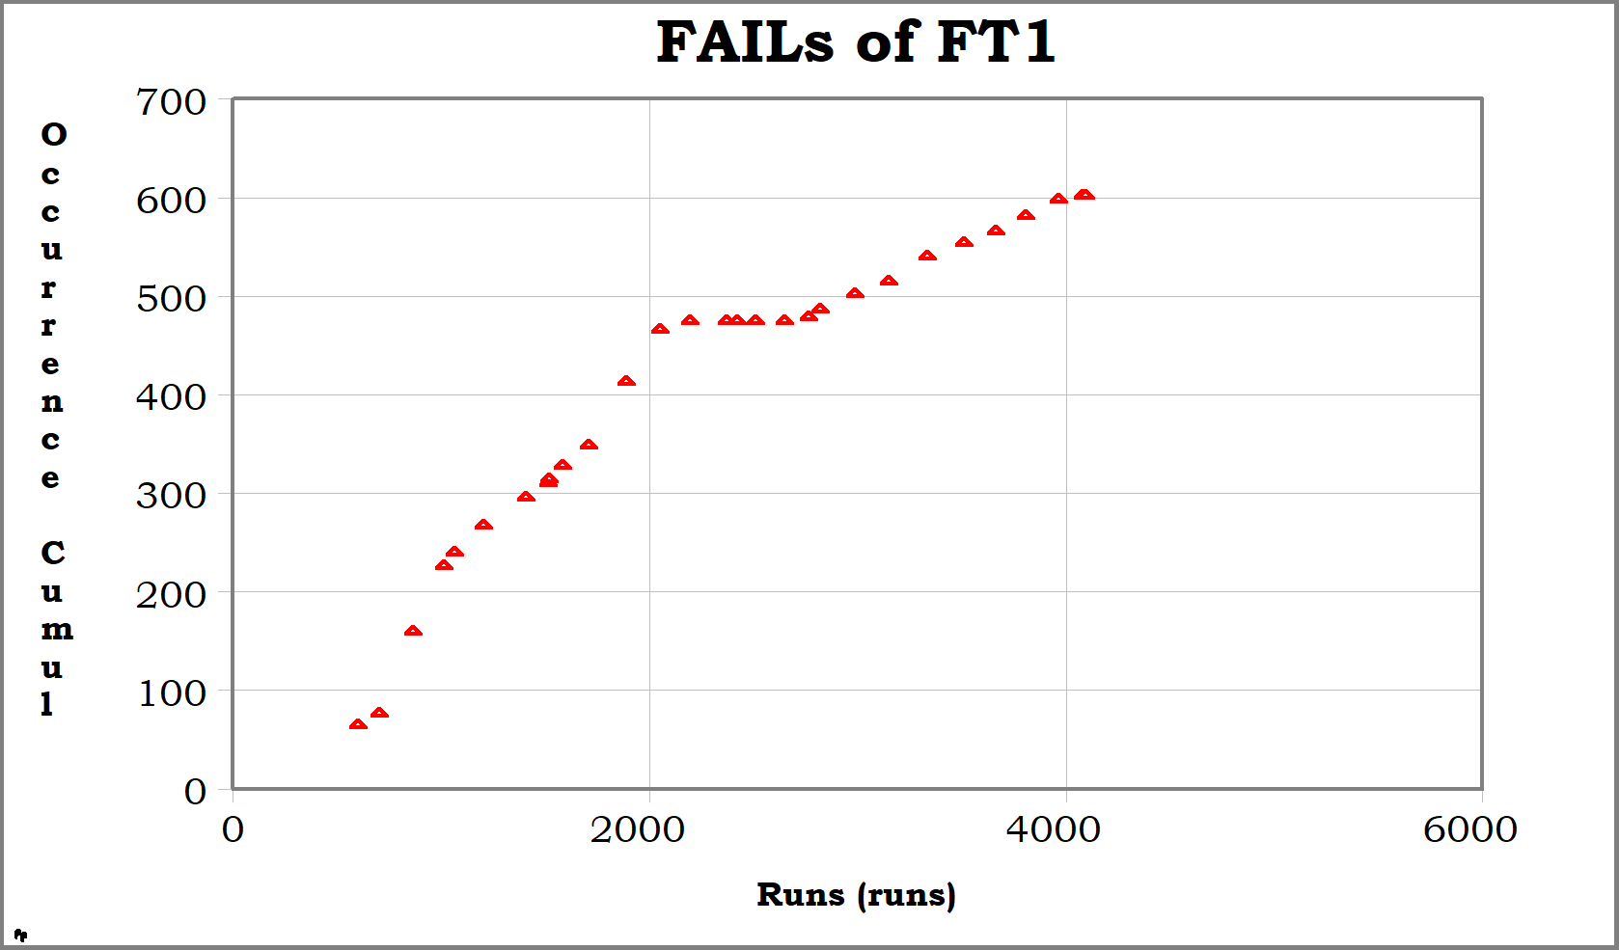
Cumu. failures vs cumu. fails of FT1
Notes:
Linear scale
X-axis
Y-axis
Last point
Already not a straight line
If this is tranformed to a loglog scale you get the basic crow-amsaa plot:

Slide 10
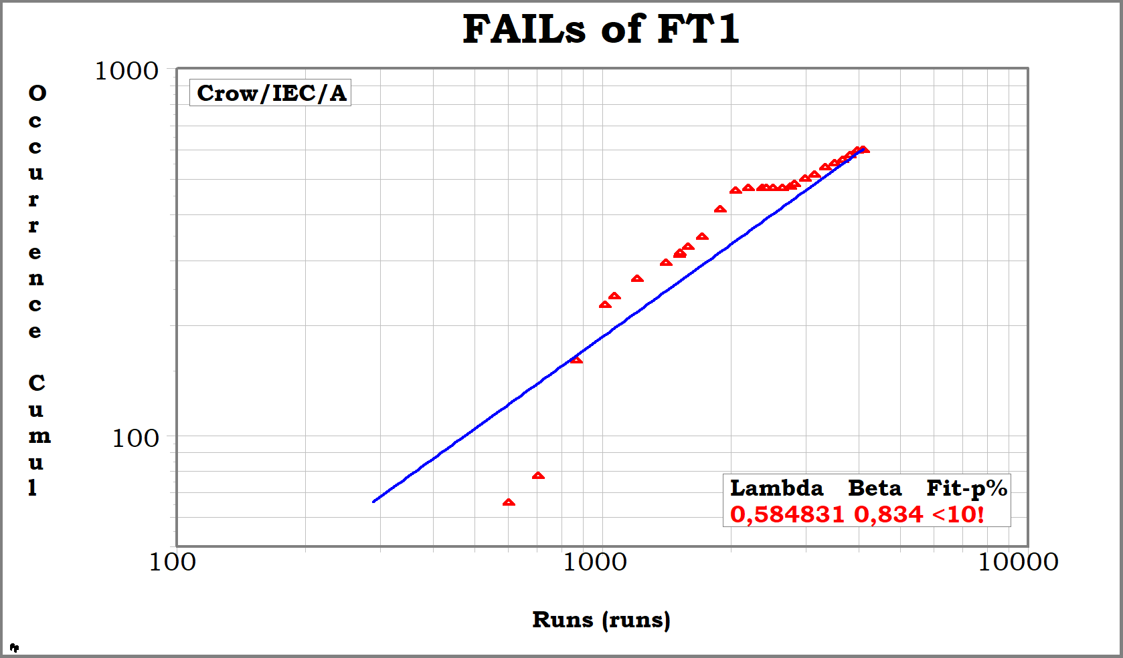
Cumu. failures vs cumu. Life of FT1
Break in trend, possibly 2x.
Notes:
Loglog scale
X axis & Y axis
The nonstraighness of the line is now amplified.
Clear changes in trend can be seen.
Related to product or process
Find data of trend changes
The same information can be visualed in a plot with failure rate on the y-axis. Often a more interesting parameter:

Slide 11
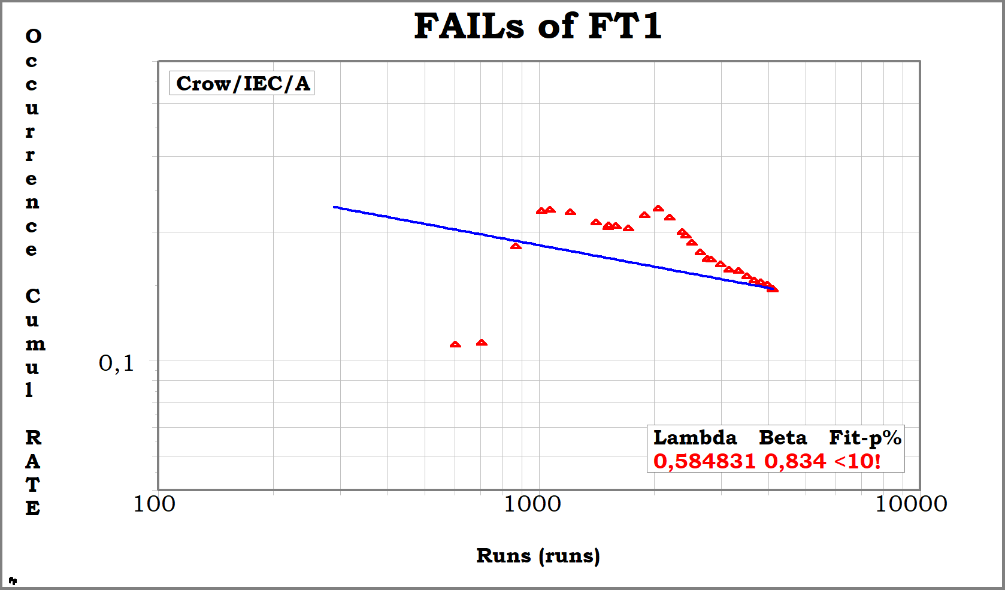
Failure rate FT1
Break in trend, possibly 2x.
Notes:
Loglog scale – now failure rate
X axis & Y axis
Slope of the line represents the trend: Are failures going down or up?
Beta =1, <1, >1.
Clear changes in trend can be seen.
Related to product or process
Find data of trend changes
Split the set into history and most recent trend to get a quantification of the demontrated failure rate.

Slide 12
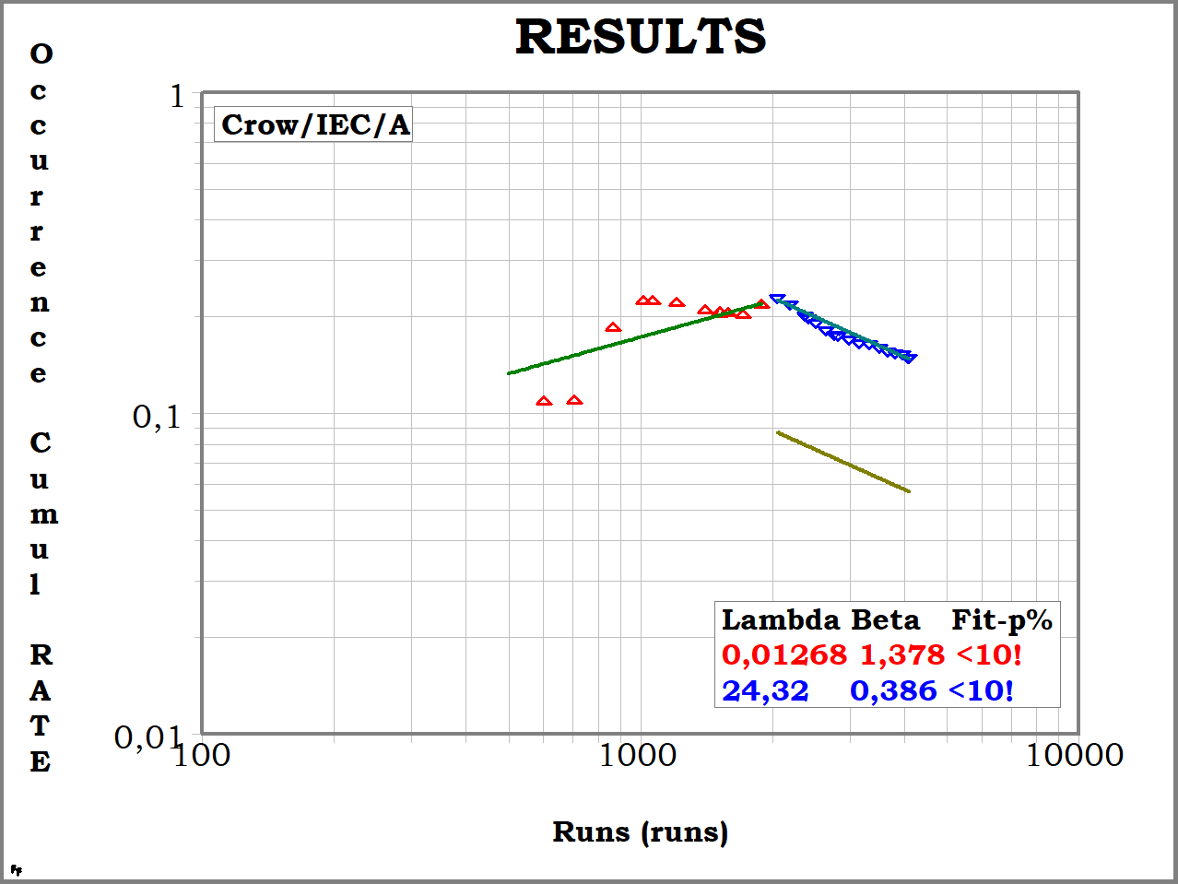
Failure rate FT1 - Split
Demonstrated: 0,147 failures per run, but decreasing
Instantaneous: 0,06 failures per run → 8 failures per day
Notes:
Split is made and most interesting part is het blue.
Beta is 0,4 → decreasing failure rate
Fit is not good. Trend not statistically proven with 90%.
Failure rate and failure to expect.
The exact same analysis is also done on the other 2 tester. Remember, 3 FT where serving one production line.

Slide 13
Summary results
 | Reliability growth | Failure rate(i) per run | Failure rate per day | Break in trend seen?
FT1 | Yes | 0,06 | Max 8 | 25-jan
FT2 | Yes | 0,09 | Max 12 | 15-jan
FT3 | Almost constant | 0,15 | Max 20 | 29-jan
Notes:
Difference between FT
All have break in trends, som in 25 januari others at 19.
The conclusion from these results are 3 folded:
Total situation improved
Why differences? 2 out of 3 can be better
Not yet at target.
Main message from the company to the product and productionline responsible where:

Slide 14

Conclusion – Case 1
Notes:
Keep on improving!
Good argumentation at the meetings
Visuall picture to talk to
Crow-amsaaa begin a usefulle tool to look at the mixed up date.

Slide 15
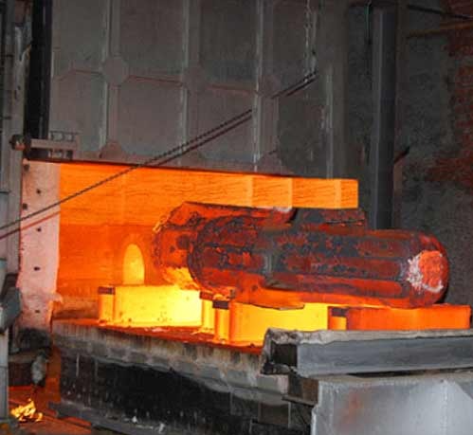
Case 2:
Planning of a revision of furnace installation

Slide 16
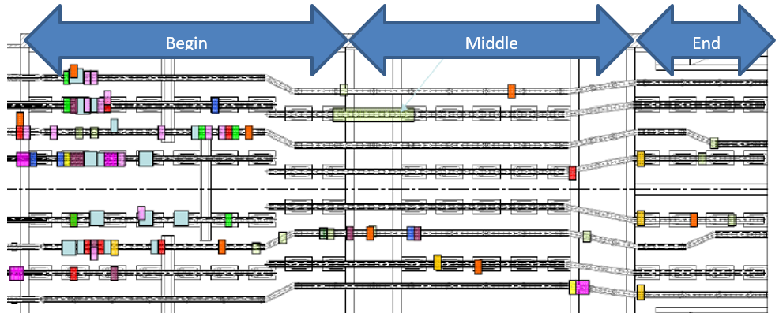
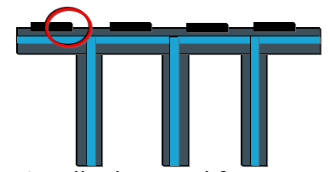
Aim of analysis
Notes:
There are leakage problems in the cooling system at two industrial furnaces.
Can the future leakages be predicted?
Do we need to speed up the already planned revision (5 years time)?
Analysis split up for the three different regions within one furnace; Begin zone and middle zone
Leakage are visually detected from outside of furnace.
Furnace stopped at to much leakage.
Load profile (e.g. temperature, size of product etc)

Slide 17
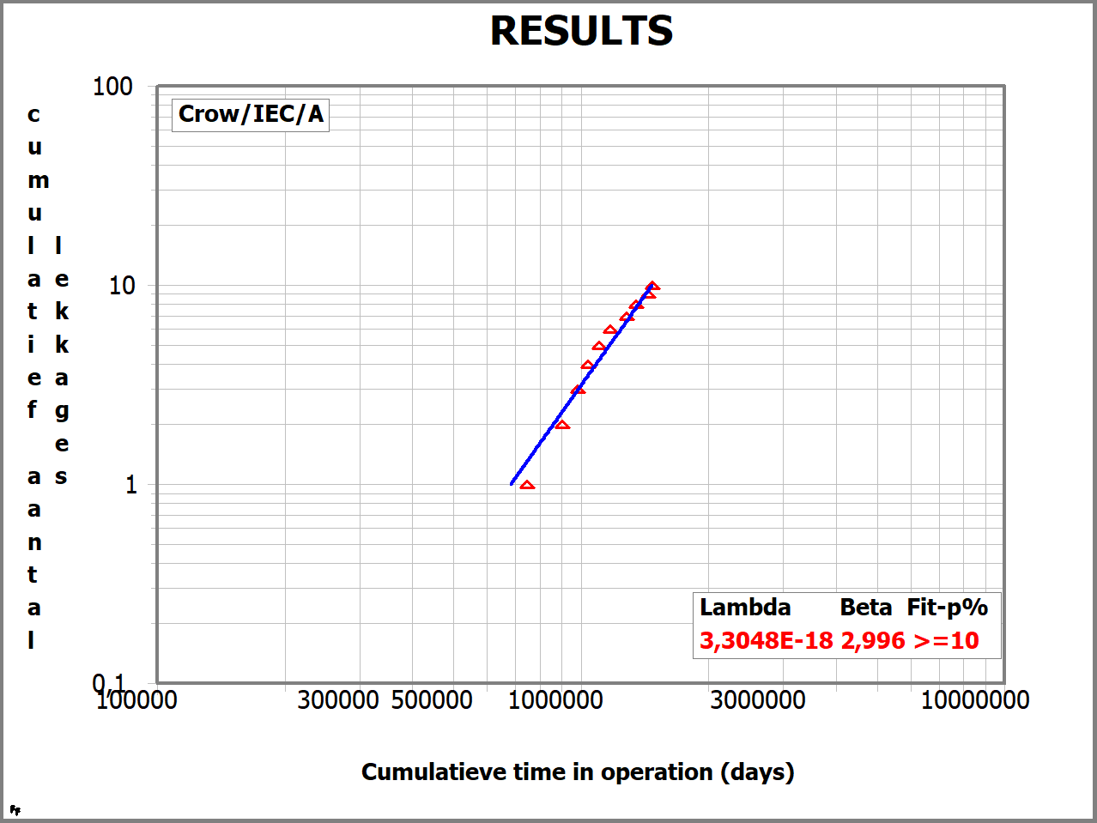
Cumu. failures vs cumu. Fails – F1
Notes:
X & Y axis
Beta is 3 → Increasing failure rate
0,0000076 failures per dag = 0,002774 x leakage per pad per year.
With 431 pads in LZ → in total minimal 1.2 pads per year failing in the loading zone.

Slide 18
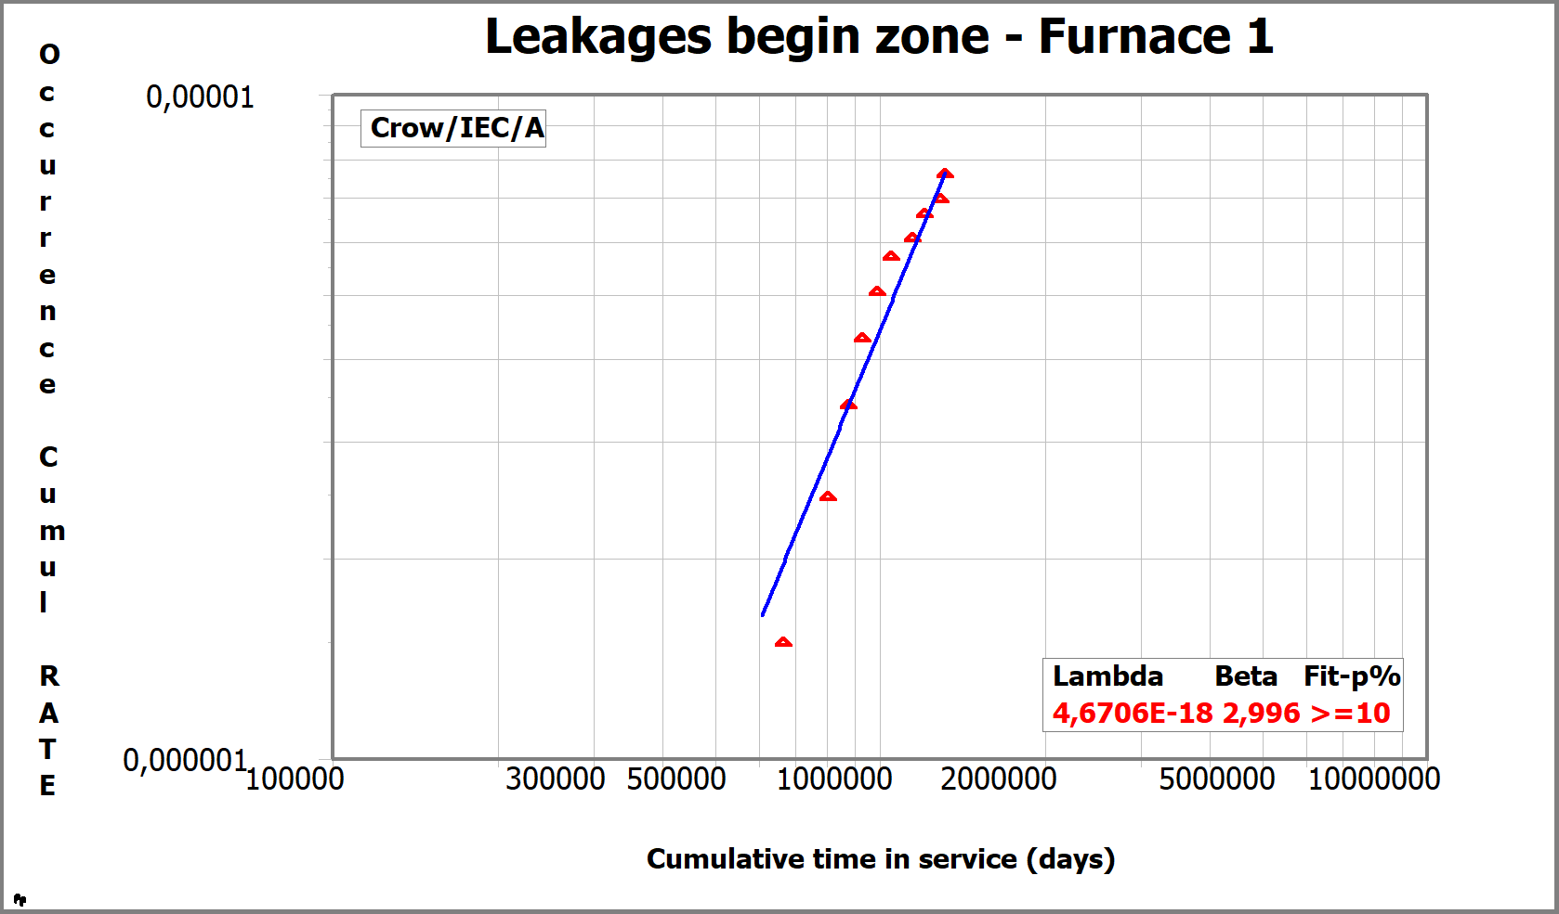
Failure rate - Loading zone of F1
Notes:
X & Y axis
Beta is 3 → Increasing failure rate
0,0000076 failures per dag = 0,002774 x leakage per pad per year.
With 431 pads in LZ → in total minimal 1.2 pads per year failing in the loading zone.
Extrapolating to 5 year can be done in the cum cum plot or per interval.

Slide 19
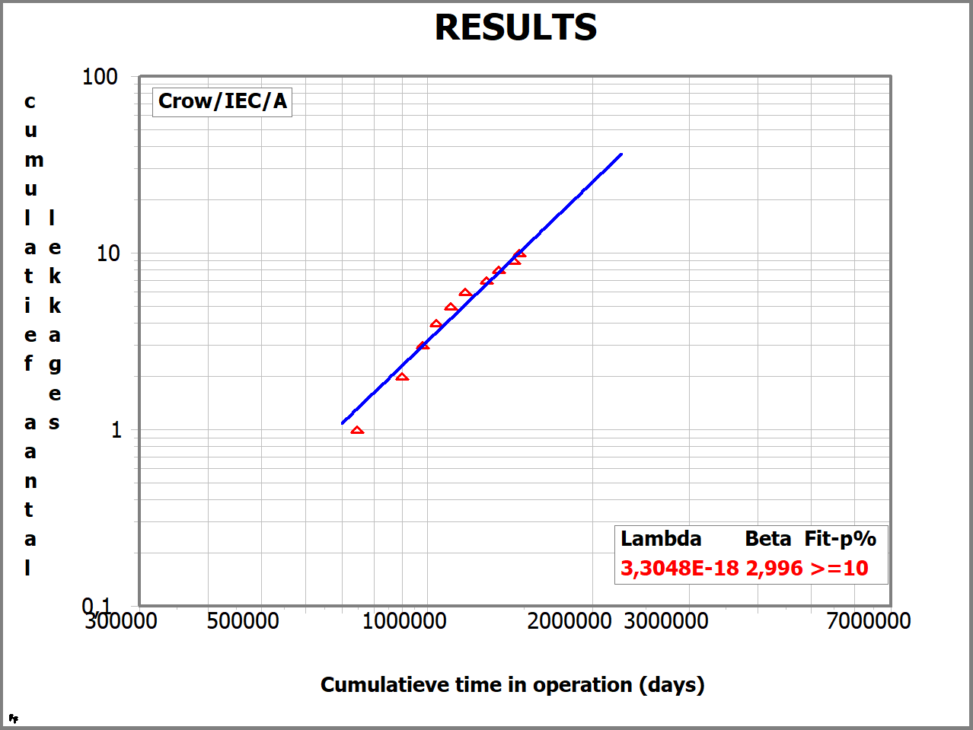
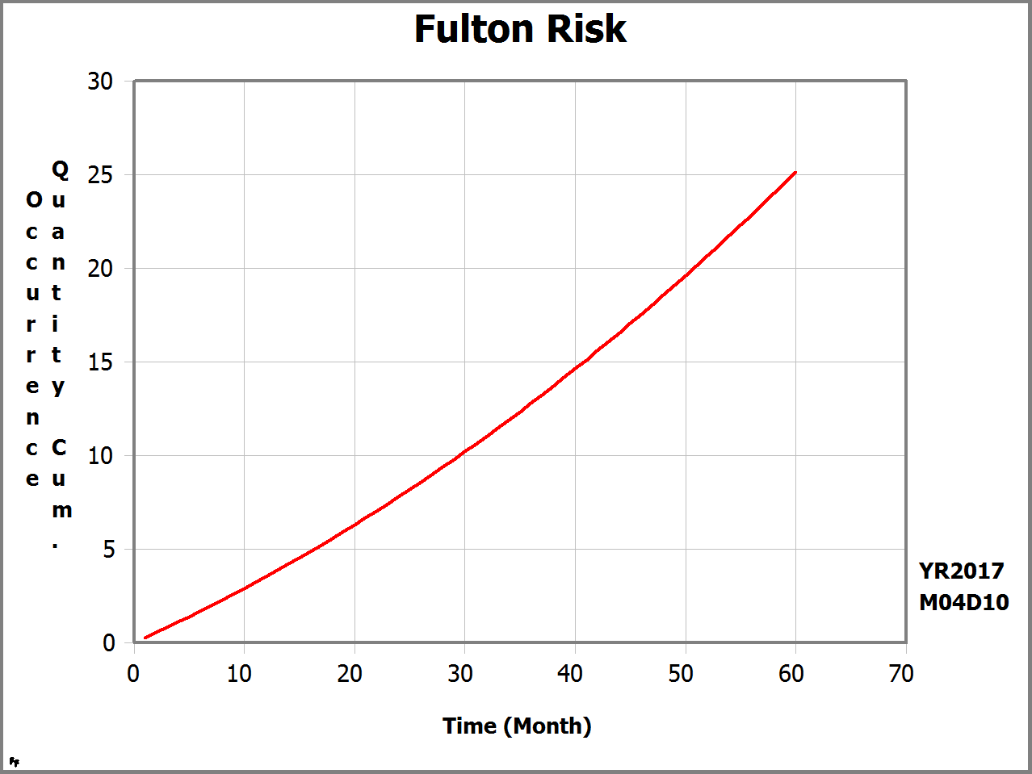
Forecast – Loading zone of F1
Notes:
Forecast of failures over the next 5 years is made for this oven.
Over the next 60 months (5 years) 25 additional leakages are expected in the loading zone of furnace 1.
The same analysis is done for the other zones of the other furnace.
This results in a clear prioritiztion in what sections need the revision first:

Slide 20
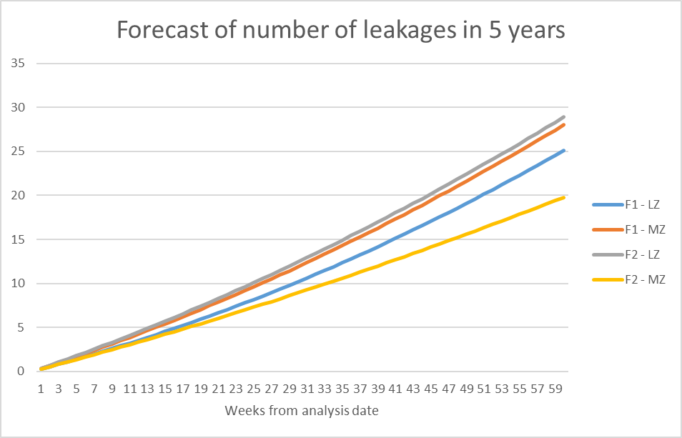
Summary of results
Notes:
Based on the failure forecast for 5 years in the future per zone and per furnace the logical priority for replacements would be: F2-LZ, F1-MZ, F1-LZ, F2-MZ.
Failing trend in this analysis is: “a leakage of cooling system in furnace which is noted and repaired at a later stage”.
This forecast assumes that product (cooling system) and process (e.g. loads, capacity, inspection) related to this failure mode stays the same.
The overall conclusion for this customer was like this situation with the bird of my sister. He choose to chew on this swing.

Slide 21

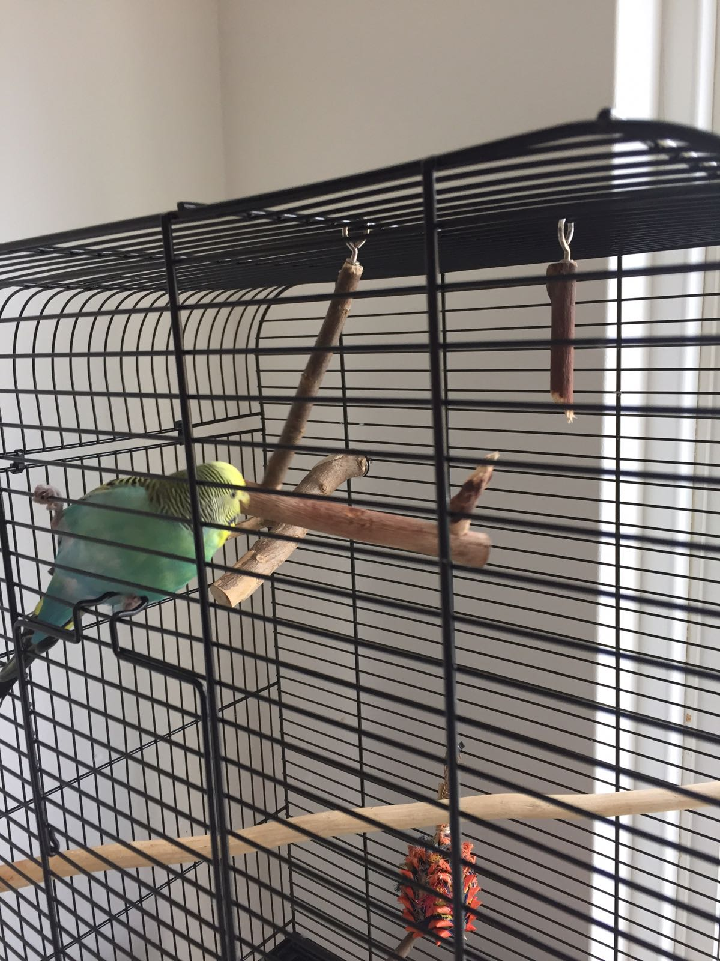

Conclusion – case 2
Notes:
Inevitable:
The risk of taking an furnance out of operation in the coming 5 years due to leakkages is very high. With an average planned maintenance interval of 34 weeks it is highly likely that the >7 leakages spread out per year will occur during the operational periods.

Slide 22

Case 3:
Field replacement costs forecast verification

Slide 23

Aim of analysis
Notes:
Due to a field problem of a product at CompanyX a budget needs to be reserved for coming years to cover the replacement costs.
CompanyX uses a calculation model to estimate this required budget.
Insurance company of CompanyX request a review of the calculation model leading to the proposed budget.
The product is a module containing 4 or 5
of the same components.

Slide 24
Overview
Sales data
Failure model
Failure forecast
Financial model
Total cost estimation
CompanyX Model
Field returns
Crow-AMSAA Data Analyse
Failure forecast
Financial calculation
Total cost estimation
Holland Innovative

Slide 25
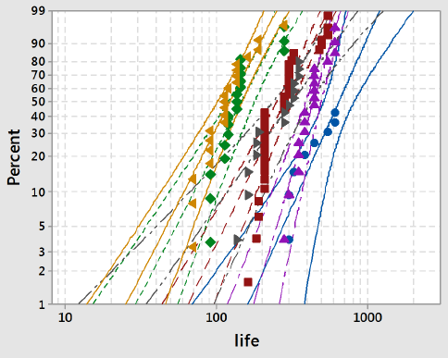
Failure model (1)
Several inputs:
Sales information (2 types)
Application distribution (temperature)
User information (10 operational hours per day)
Results from acceleration life tests at different temperatures.
Failure definition Module:
20% or more of the components have failed
Notes:
2 types with possible different failure behavior.
Main assumptions user case
Application distribution
10 burning hours per day

Slide 26
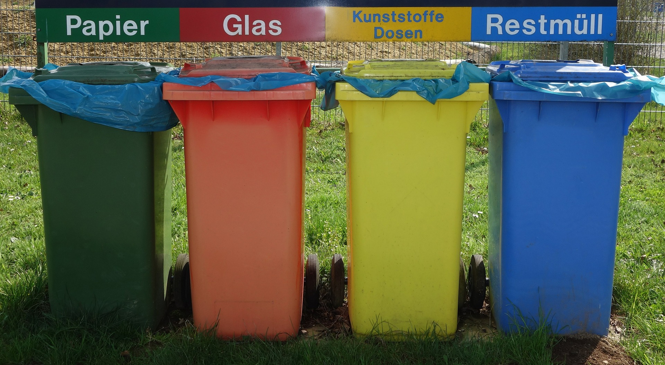
Failure model (2)
Notes:
100 % of sold products will have technically failed at reference date over 37 months.
Customer return rate may be lower than technical failure forecast due to:
Components can ‘recover’ after period of very low performance.
Due to variation (confirmed by Weibull results) not all components in one module may fail simultaneously causing a low decrease in overall performance of the product.

Slide 27
Financial model
Based on:
Sales per region
Replacement cost per module
Percentage “Samples free of charge “
Percentage “Customer Notice/Complaints” per region
Total estimated costs:
1.000 k€

Slide 28
Overview
Sales data
Failure model
Failure forecast
Financial model
Total cost estimation
Failure definition Module:
20% or more of the components have failed
CompanyX Model
Field returns
Crow-AMSAA Data Analyse
Failure forecast
Financial calculation
Total cost estimation
Failure definition:
“Customer returns due to less performance”.
Holland Innovative
Notes:
Based on returns from the field: “2016-11-16_Sales and Field Return data.xls”
Revision 1: Total sold 302.000, total now returned 16.250 (5%)
Revision 2: Total sold 305.000, total now returned 59.750 (19%)
The supplied information is suited for Crow-AMSAA trend analyse. No exact age (hours) to failure are known, so no Weibull analysis is possible
Forecast is created assuming no renewal of the failures with the same product.

Slide 29
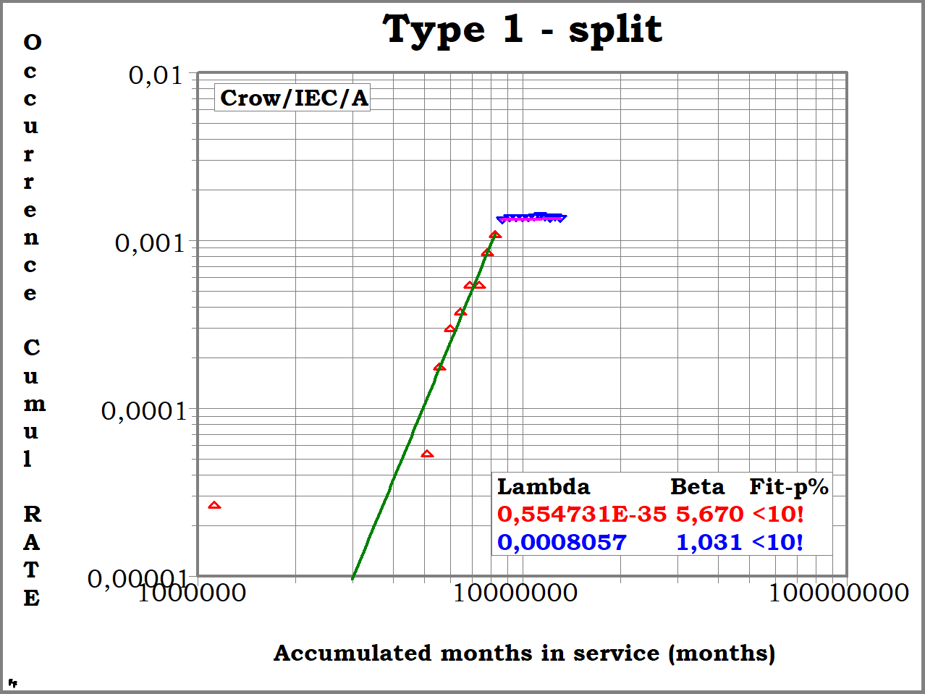
Field data - type 1
Stabilizes to constant failure rate
Notes:
Break in trend at 8.786.640 months runtime → ca january year X.
Beta of 1 most recent part points to almost constant failure rate.
Critical customers early complains
Ramping up of fleet
Redesign implemented.

Slide 30
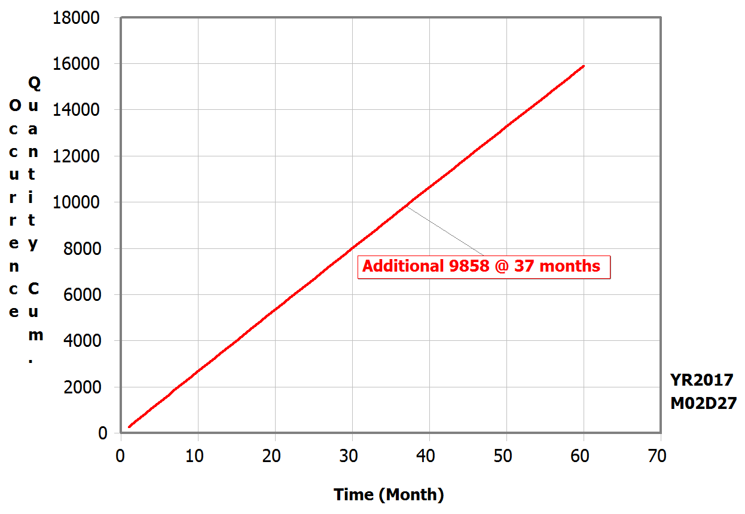
Failure forecast – type 1
Failures continue after reference date
Notes:
No renewal of the failures with the same product.
Forecasts for reference date is an additional ca 10.000 failures.
Total becomes 26.250, which is 8,7% of installed base type 1

Slide 31
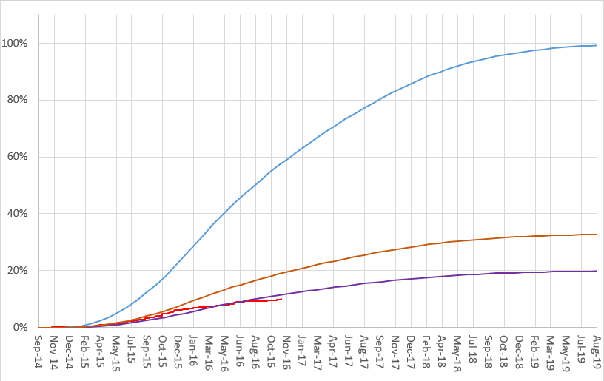
Model comparison
Failure Model
Financial model
Field returns
Based on field data

Slide 32
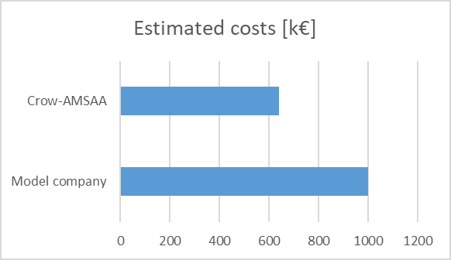
Conclusion – case 3
Cost estimated based on field data is 36 % lower
Notes:
Costs estimation based on current received field data of CompanyX is 36% lower than cost estimation from the CompanyX
→ Reserved budget seems to be sufficient
A new break in trend in returns may cause the failure and cost forecast to change
No reason to believe failures will stop at reference date 37 months from now.
→ Additional budget/actions may be required for period
after 5 year Warranty
To conclude we have seen 3 different cases: Bladiebladiebla
Different application
Dirty data
Insights, decisions

Slide 33

Crow-AMSAA - Summary
Notes:
Relatively quick, simple, save your data when it seems to be too dirty or not interesting.
Relatively simple methodoly can a very usefull tool in you engineering toolbox
Can bring valuable insight in your seamlessly unusable dirty data.
To cut short: Always handy to have on board!
TBD

Slide 34
Contact information
Ir. Dorien Lutgendorf
Reliability Specialist
Holland Innovative
www.holland-innovative.nl
dorien.lutgendorf@holland-innovative.nl
+31 6 3835 8663
www.linkedin.com/in/dlutgendorf

Slide 35
Questions
Thank you for your attention.
Do you have any questions?

